Slide 1
Machine Learning INET
Fall 2024

Slide 2
SVM – support vector machine
Perceptron
Adaline
Logistic regression
Linear classifier: W^{T}x
Method: Gradient Descent
Logistic loss: log(1+exp(-yW^{T}x))
Adaline loss: SME
Perceptron loss: max(0, -yW^{T}x)
Today: SVM
Linearly separabale | linearly non-separable
Hinge loss

Slide 3
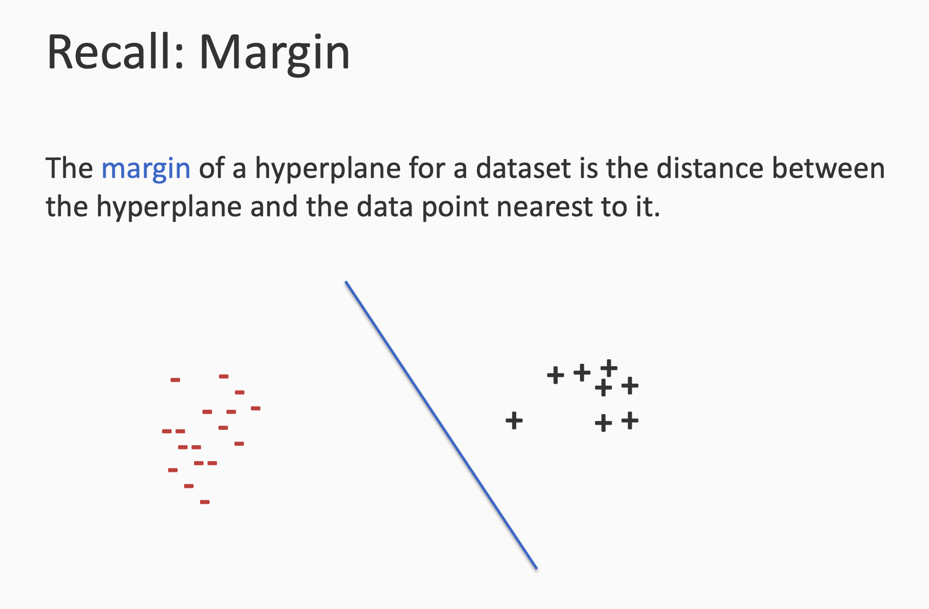

Slide 4
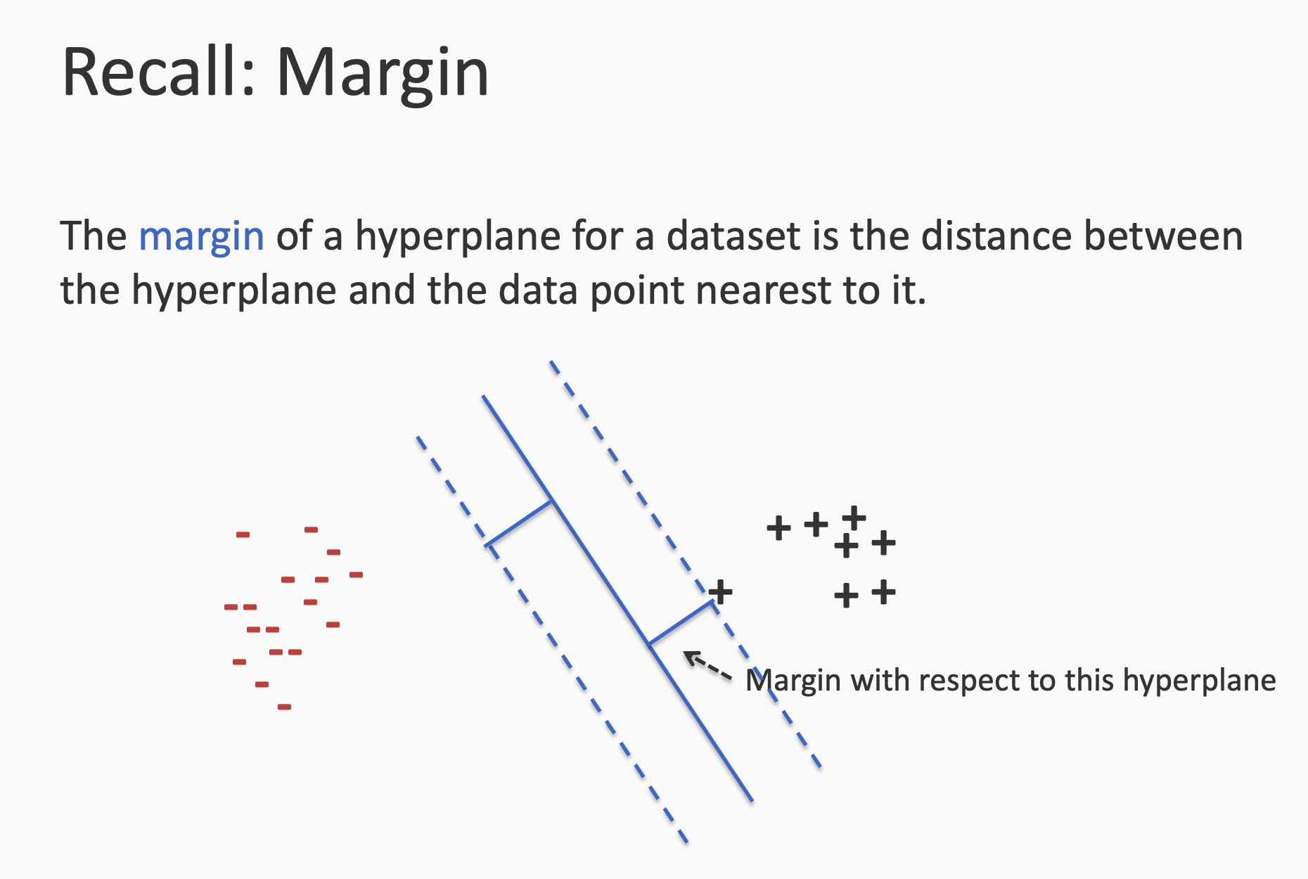

Slide 5
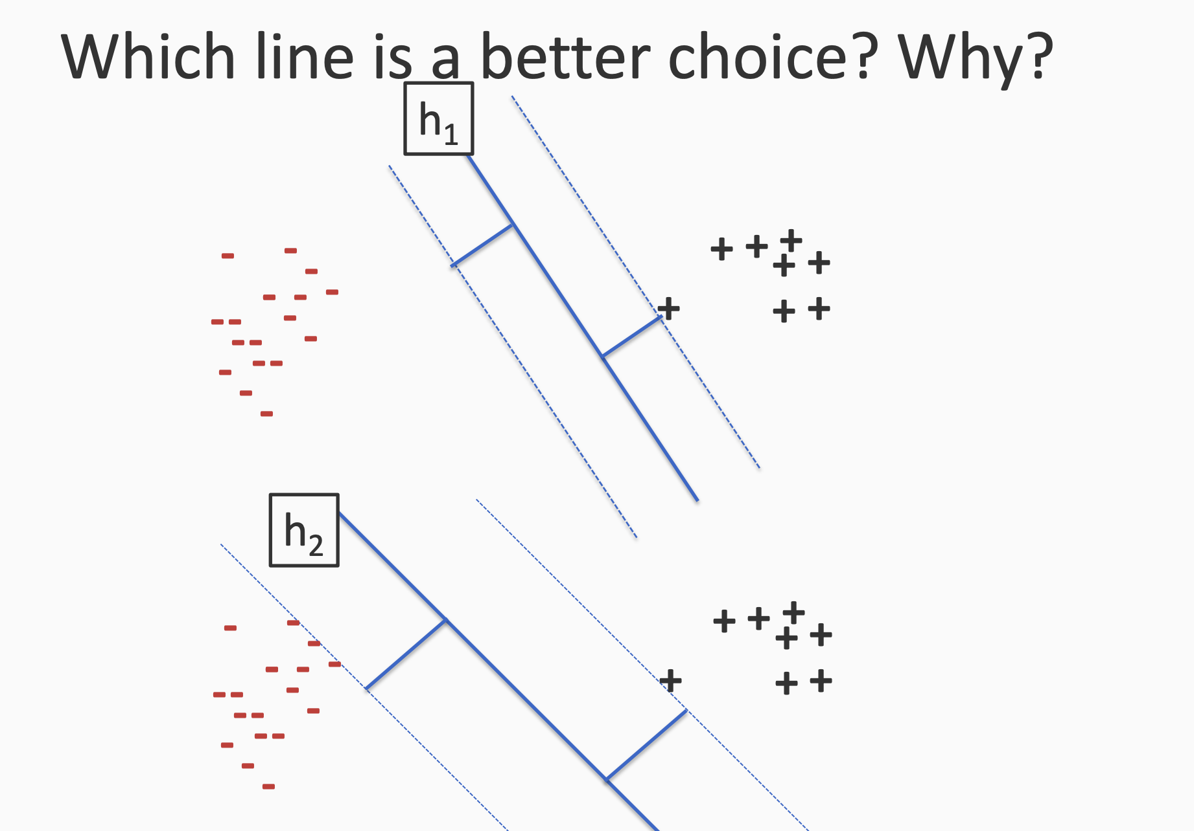

Slide 6
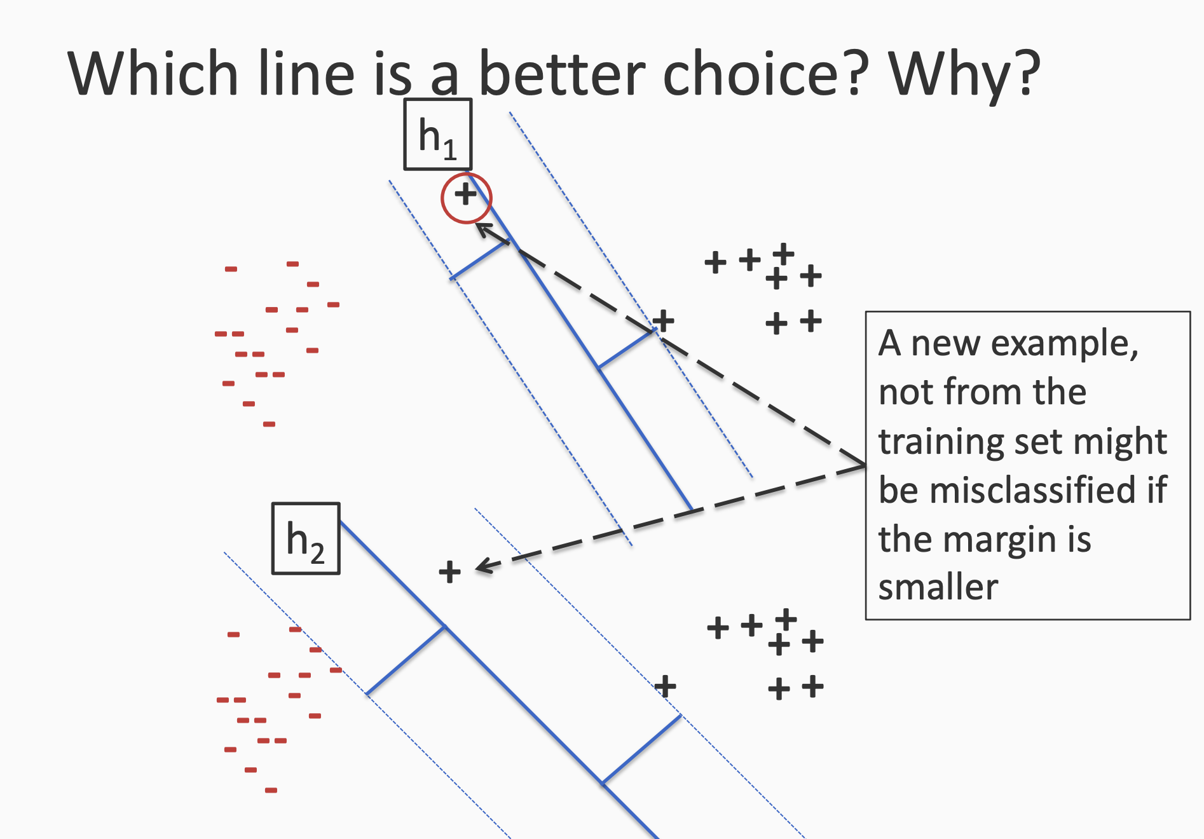

Slide 7
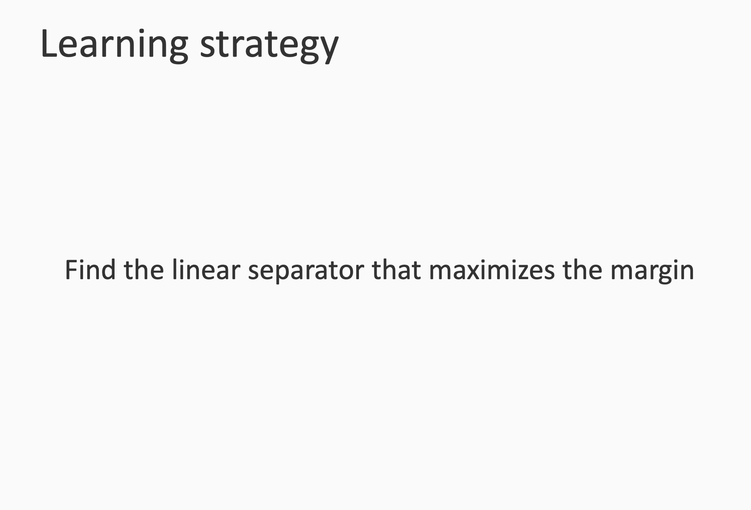

Slide 8
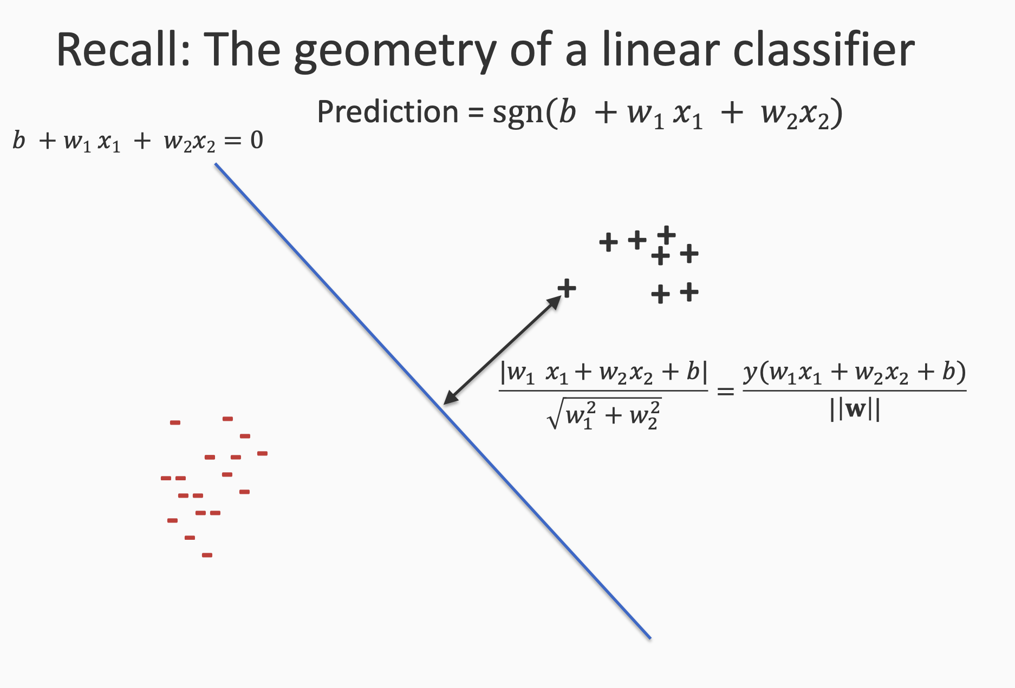

Slide 9
Absolute value: |w₁x₁ + w₂x₂ + b|
(x₁, x₂) as data point on the left side of hyperplane =>
Sign(w₁x₁ + w₂x₂ + b) < 0
Also we know that y = -1
Therefore y(w₁x₁ + w₂x₂ + b) is positive =>
|w₁x₁ + w₂x₂ + b| = y(w₁x₁ + w₂x₂ + b)

Slide 10
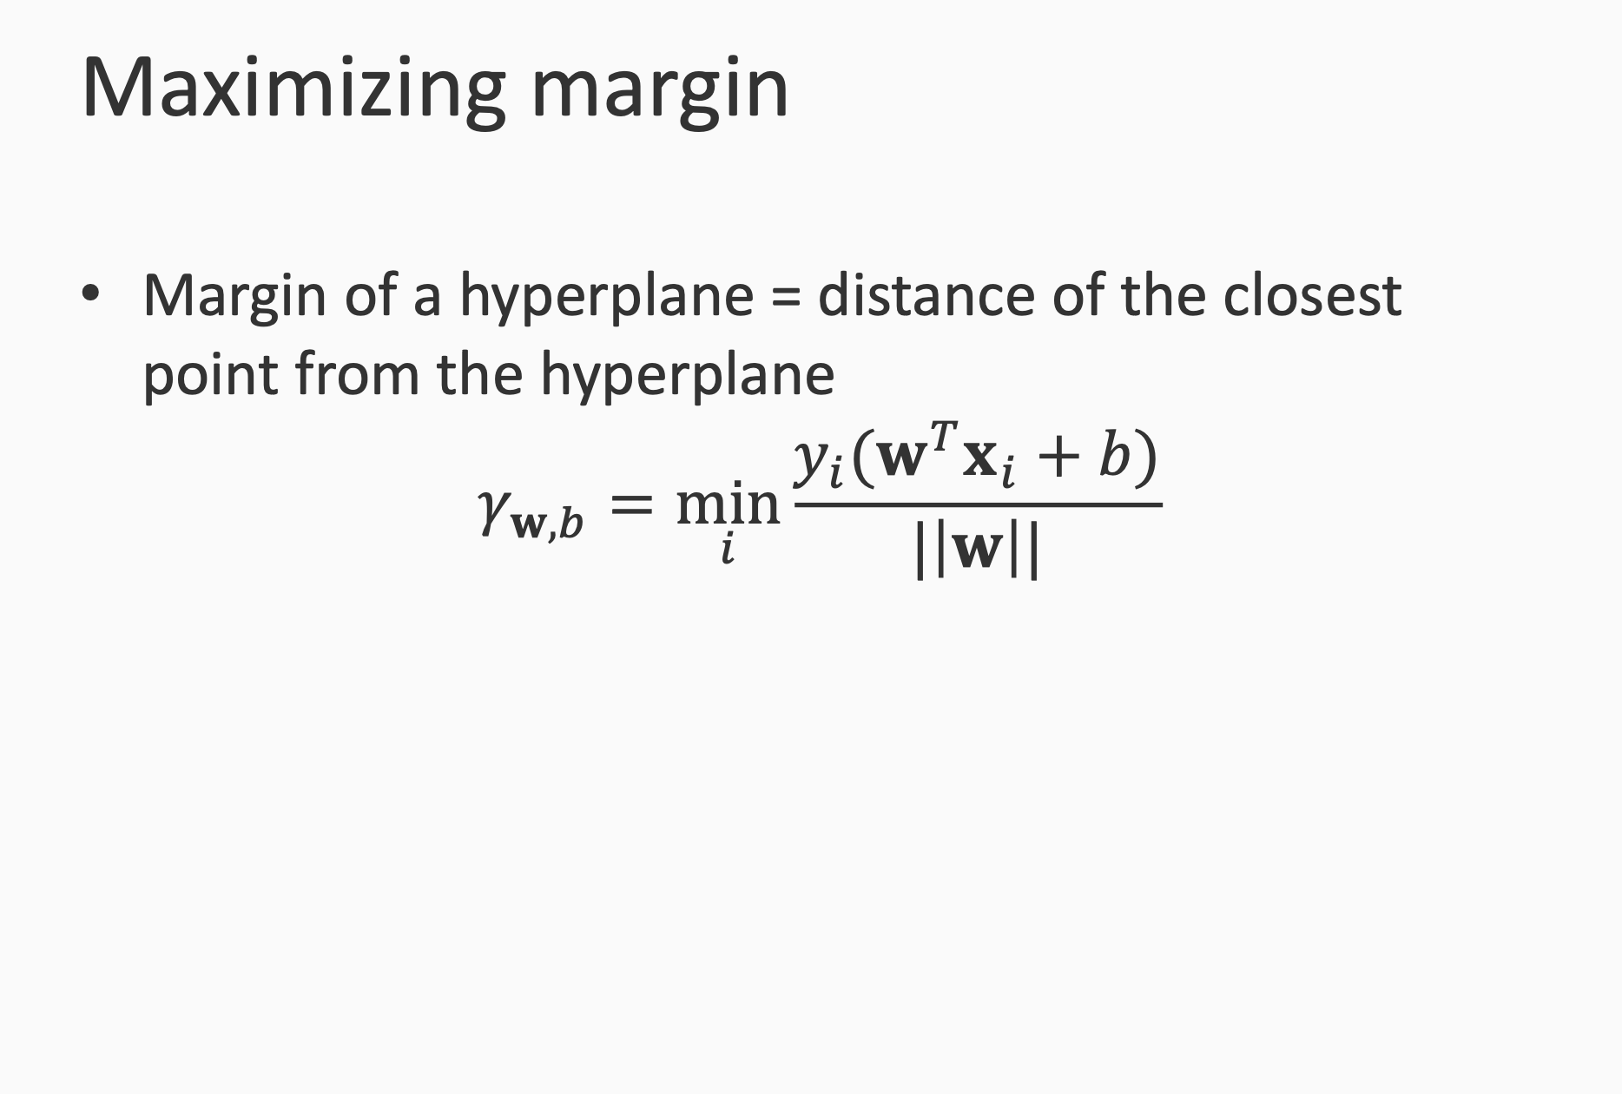

Slide 11
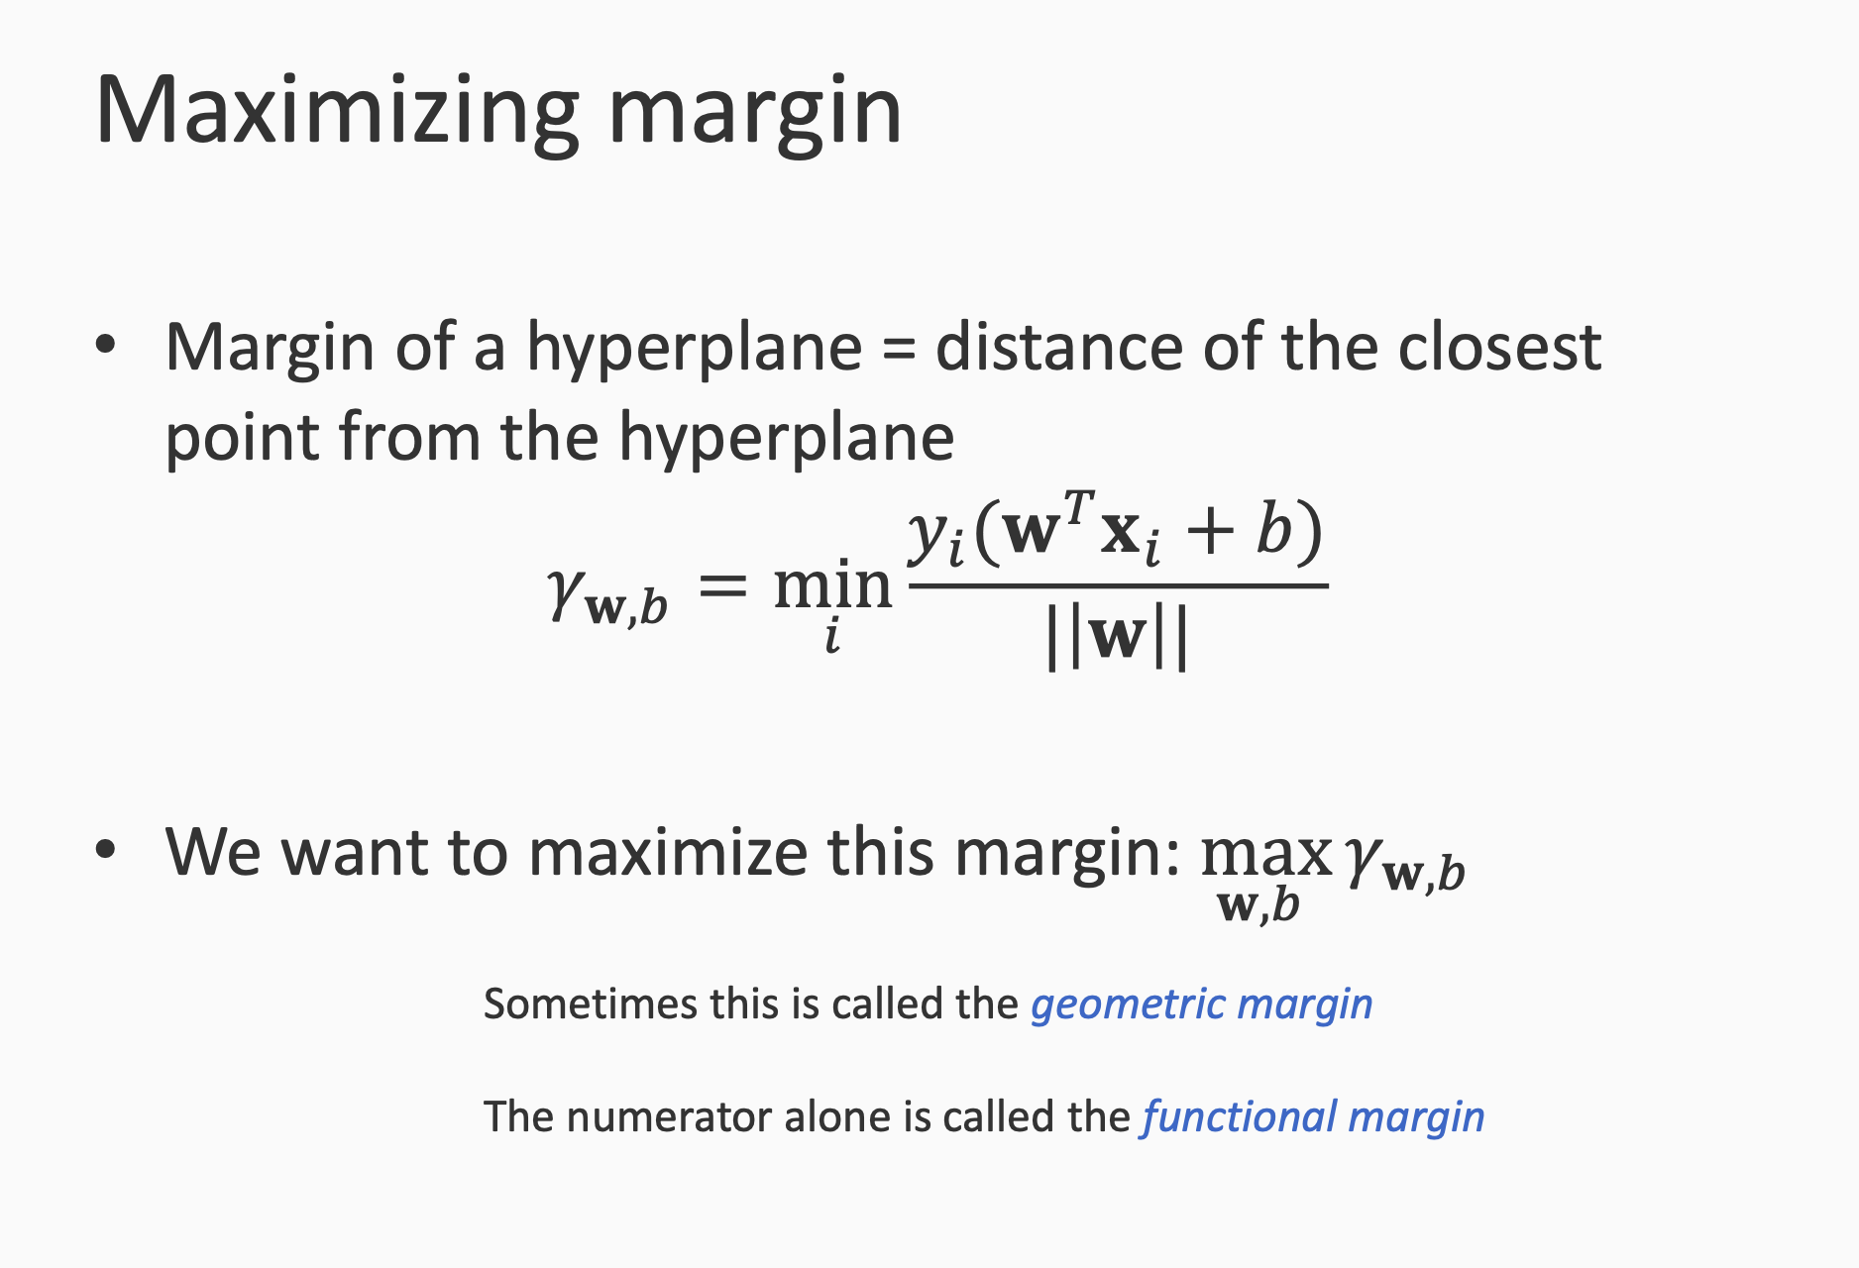

Slide 12
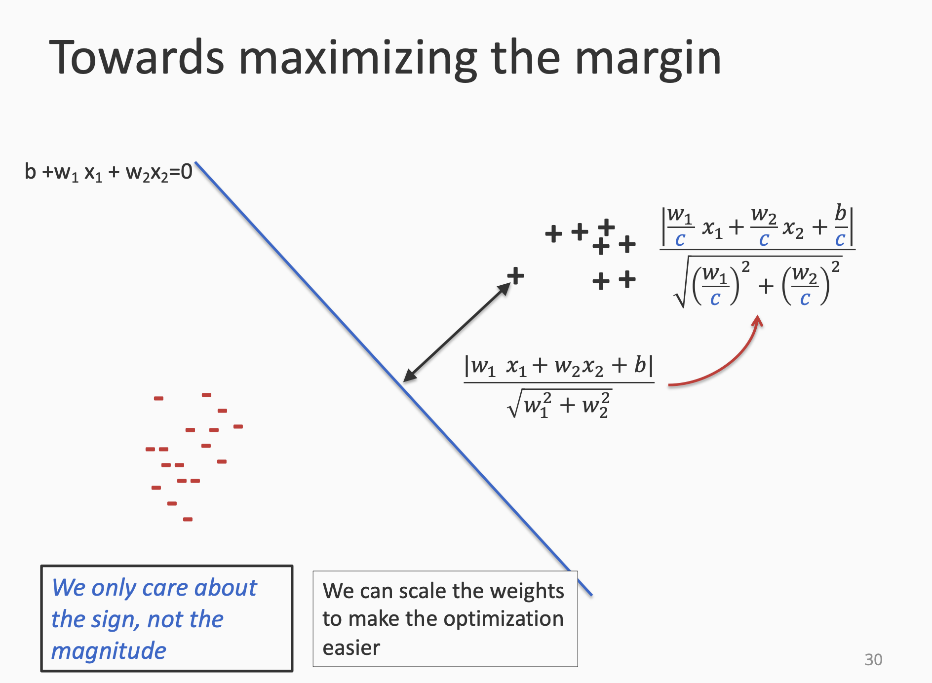

Slide 13
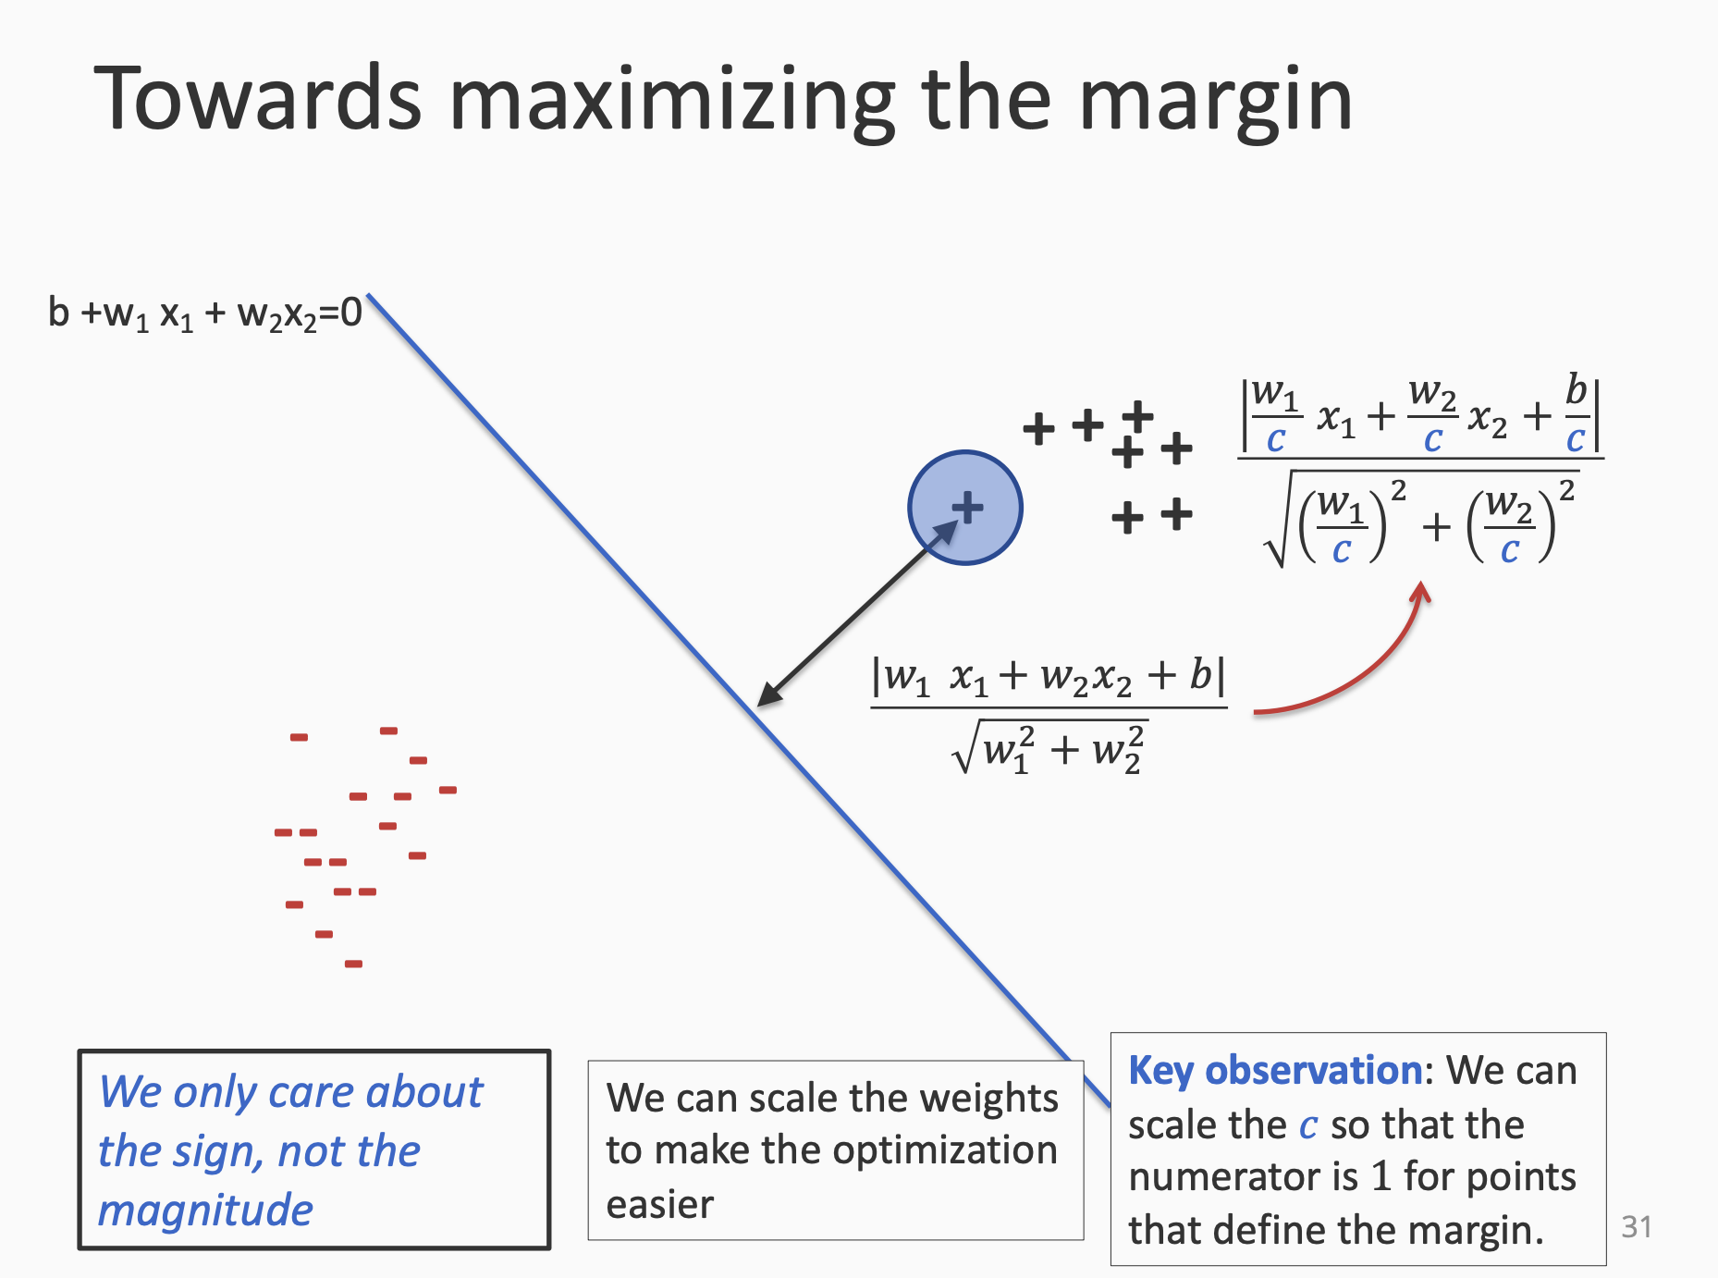

Slide 14
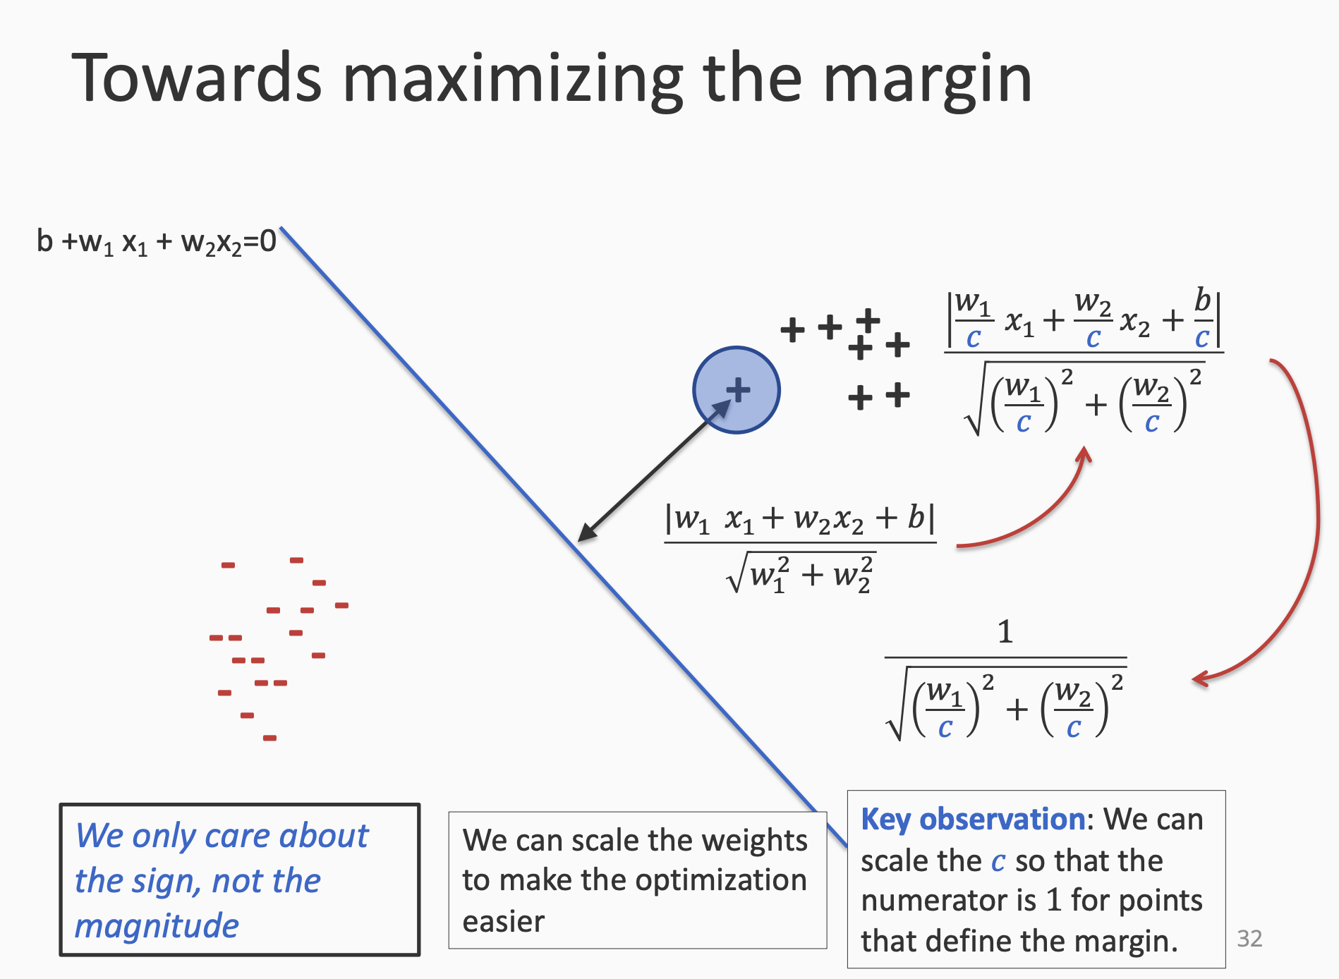

Slide 15
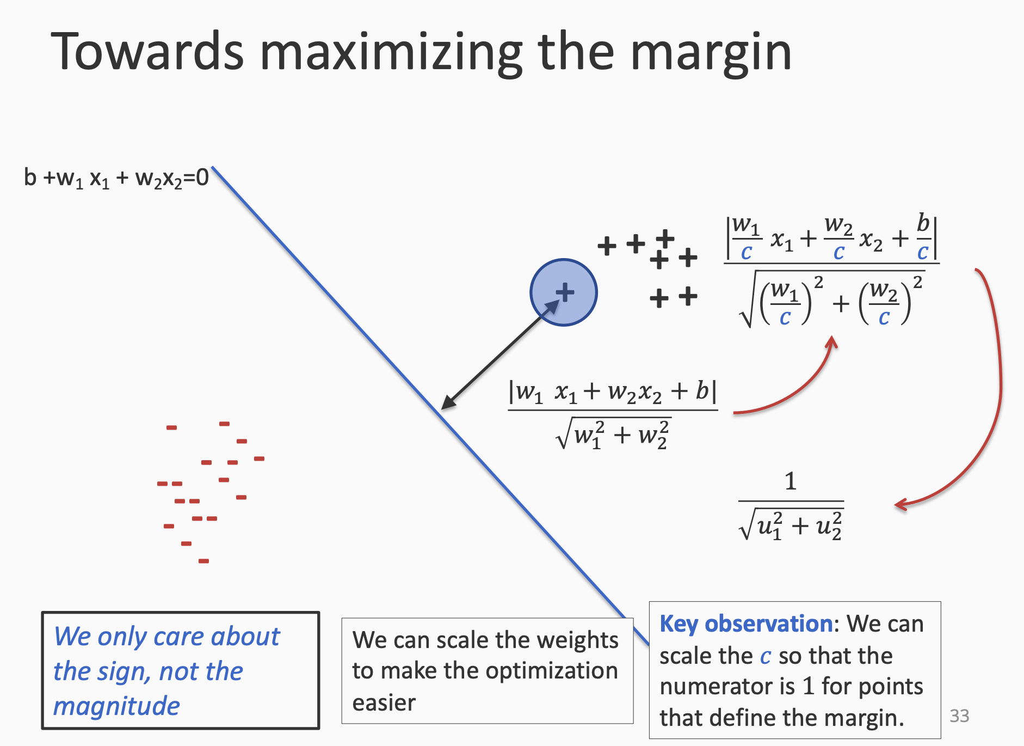

Slide 16
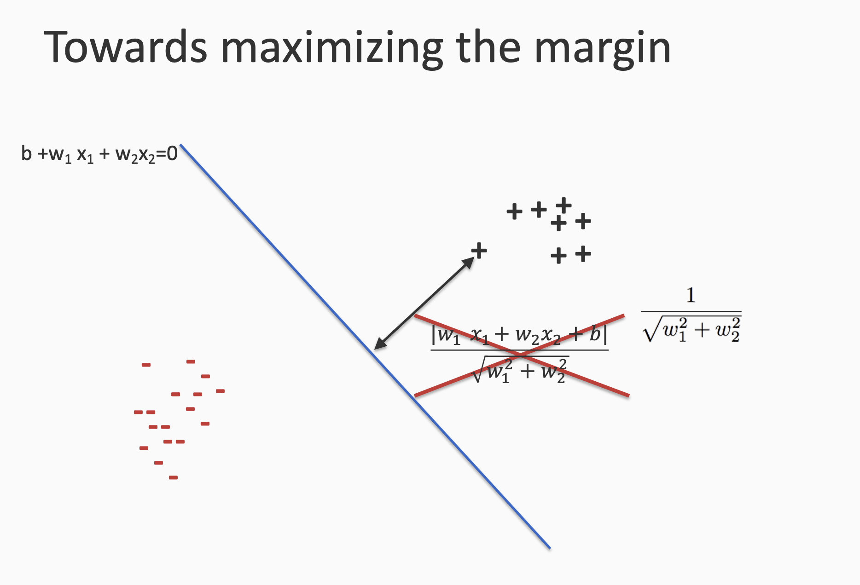

Slide 17
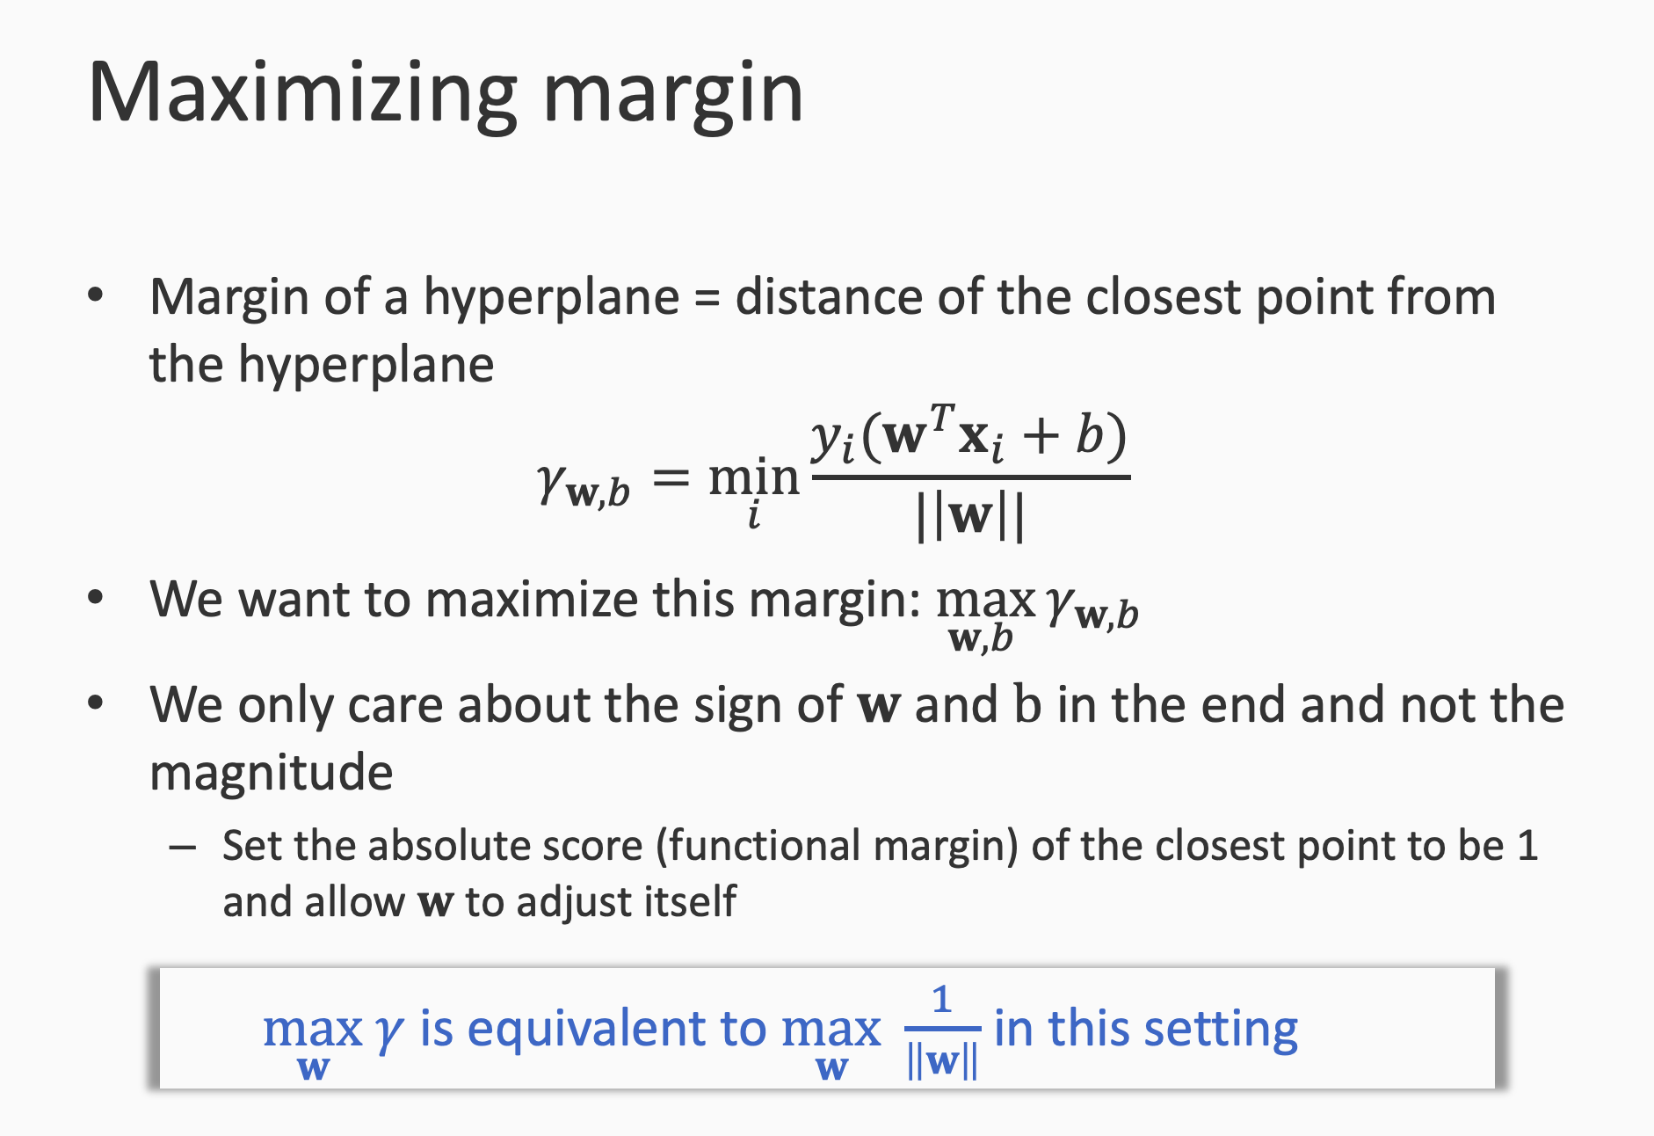

Slide 18
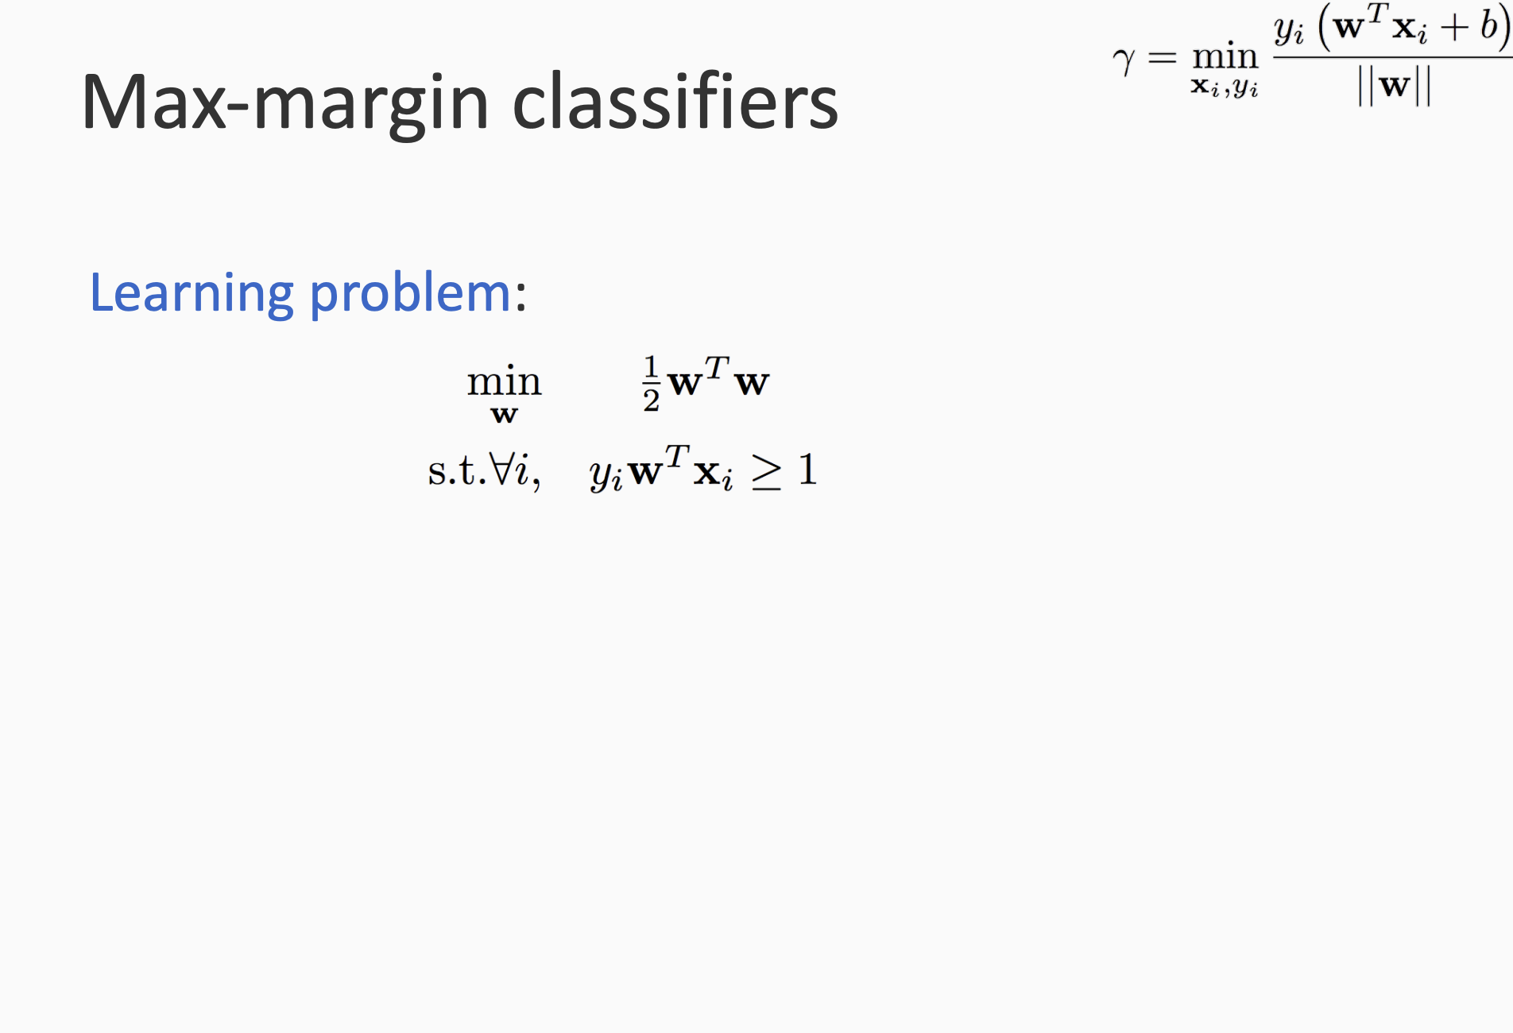

Slide 19
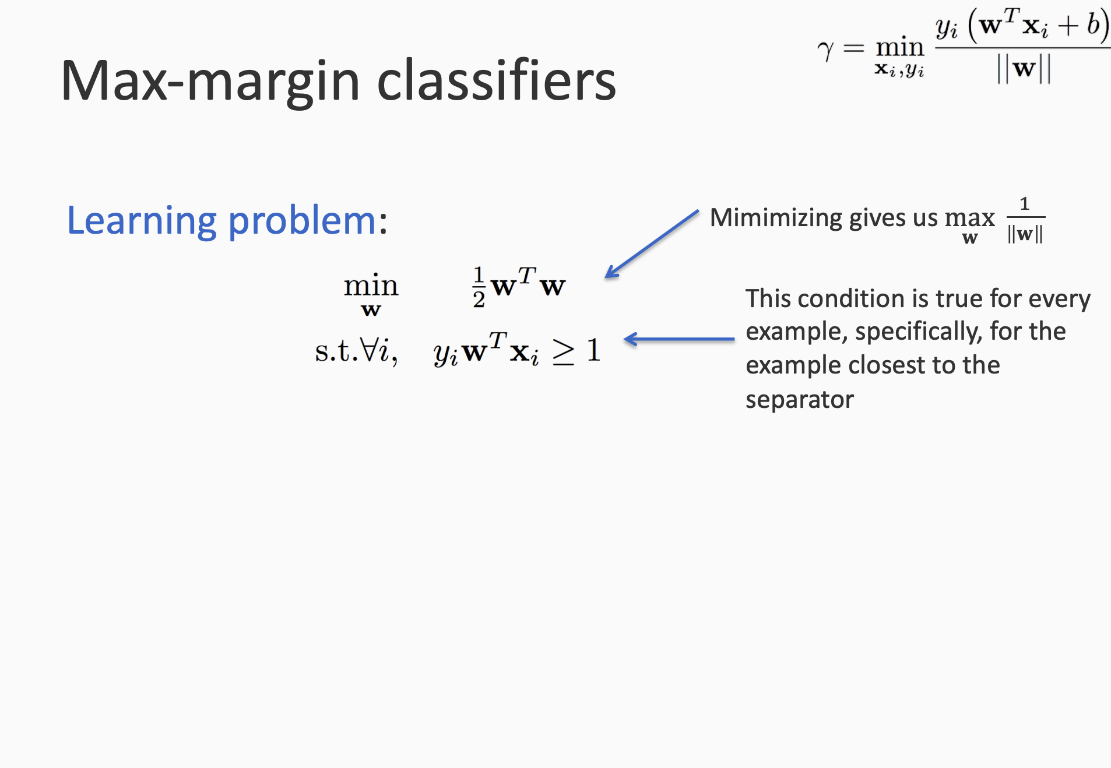

Slide 20
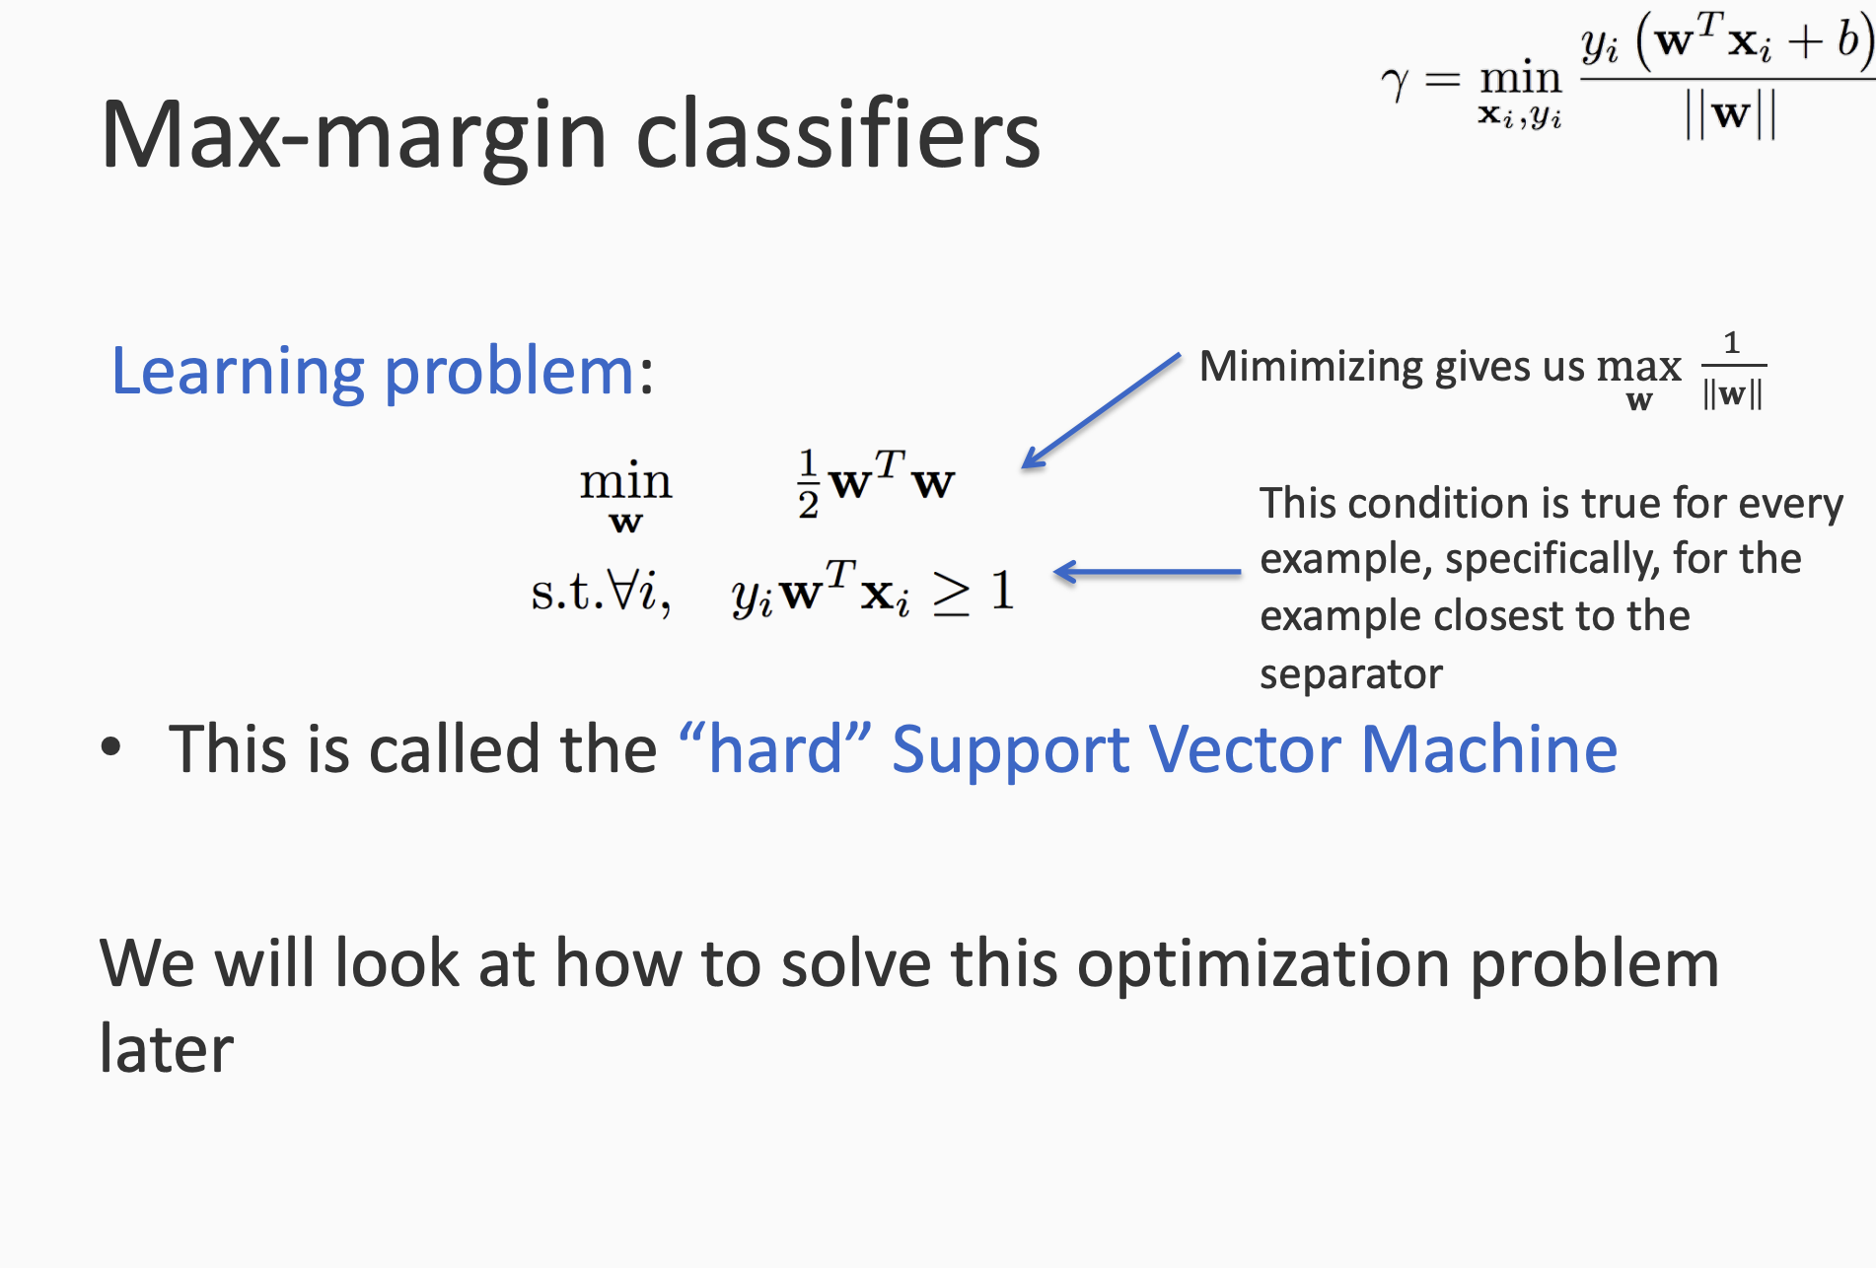

Slide 21
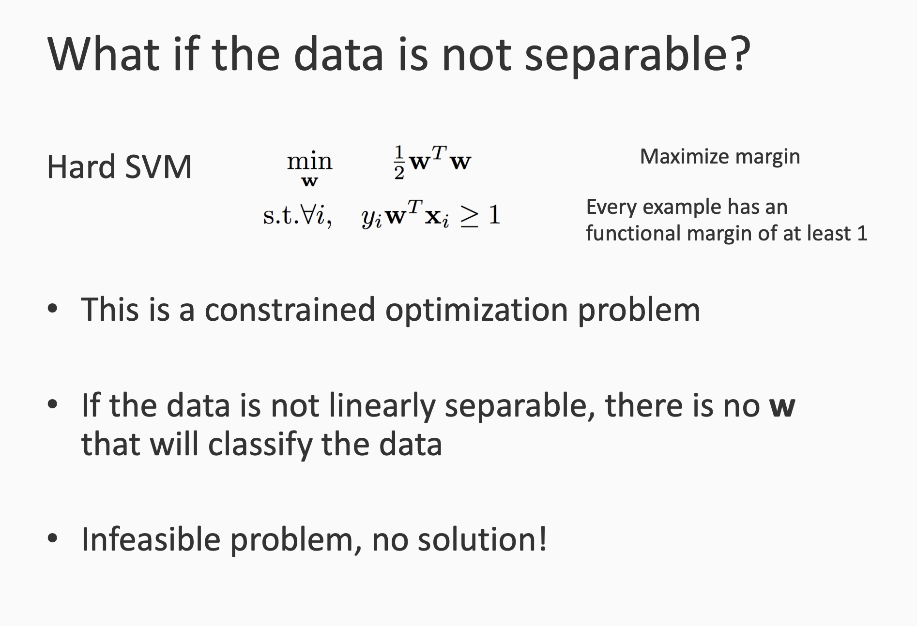

Slide 22
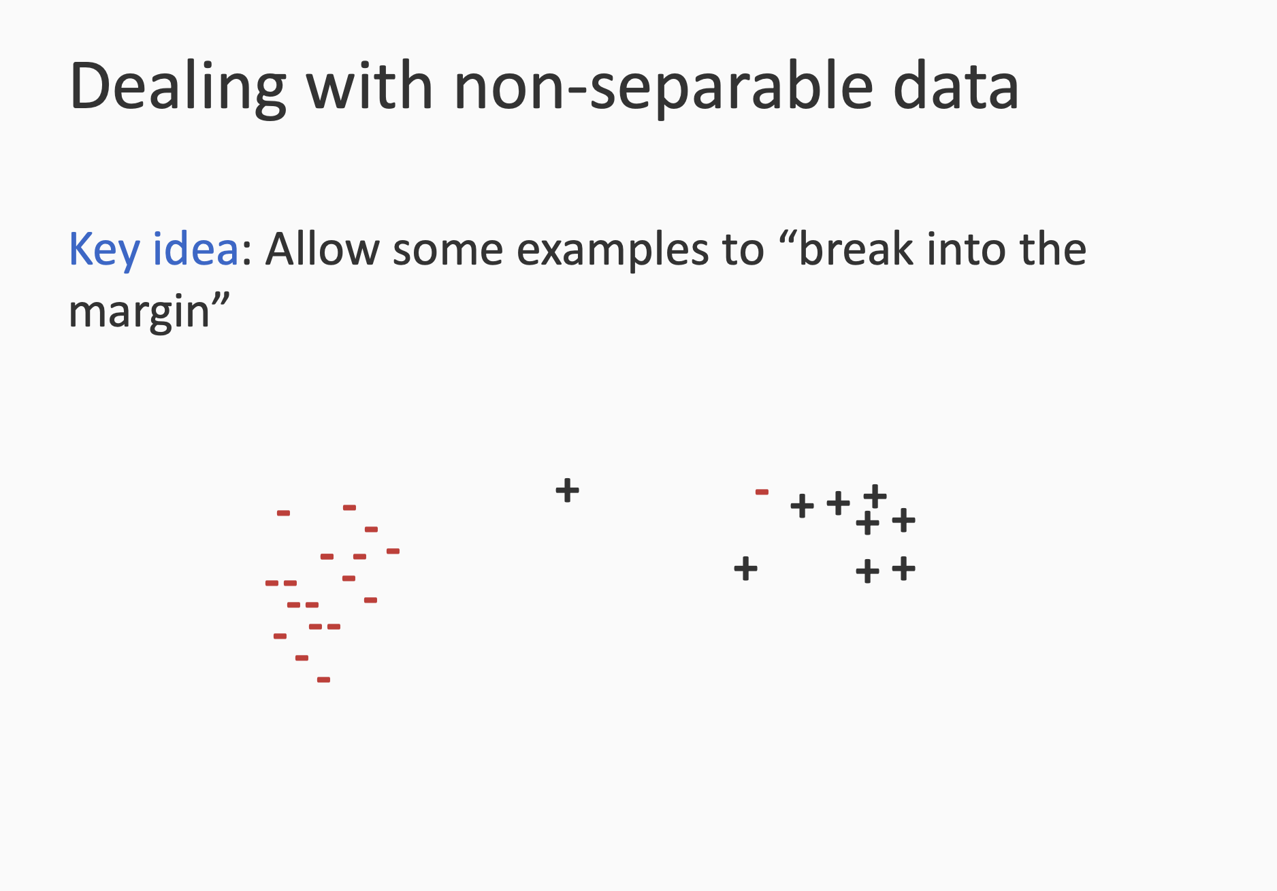

Slide 23
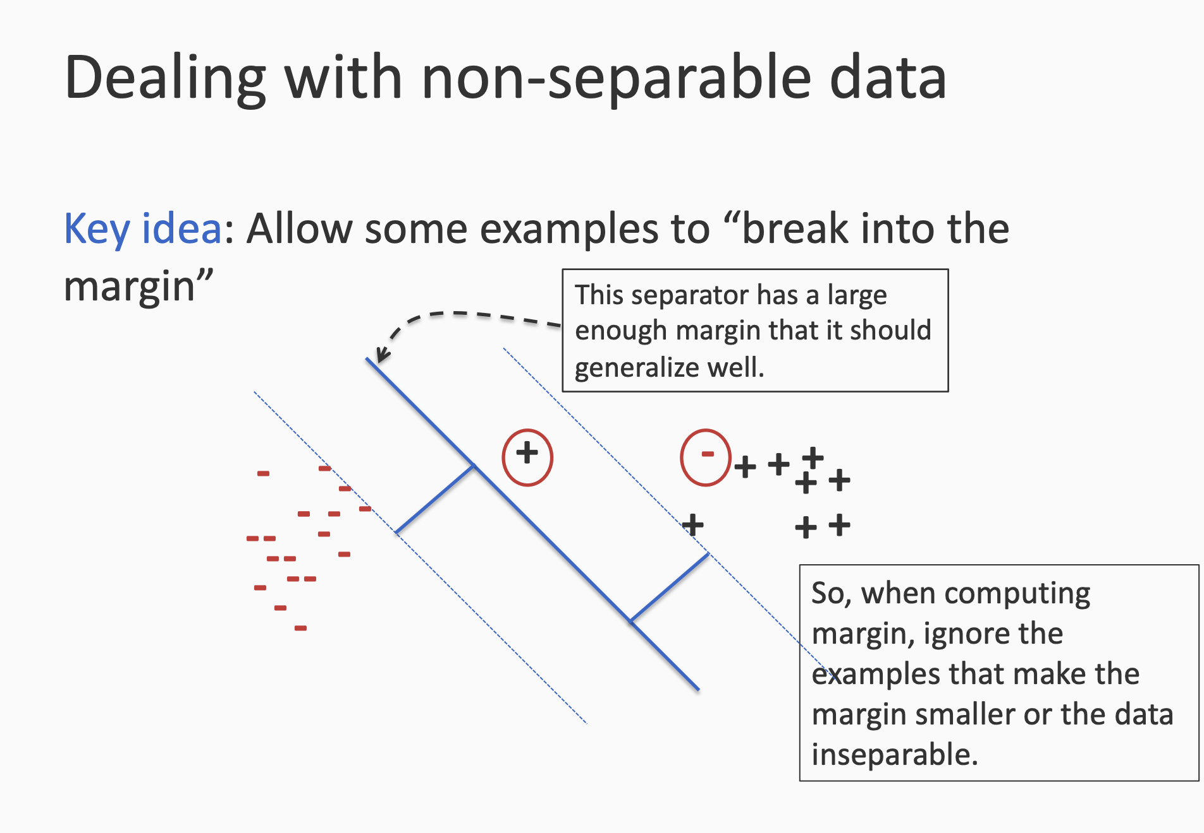

Slide 24
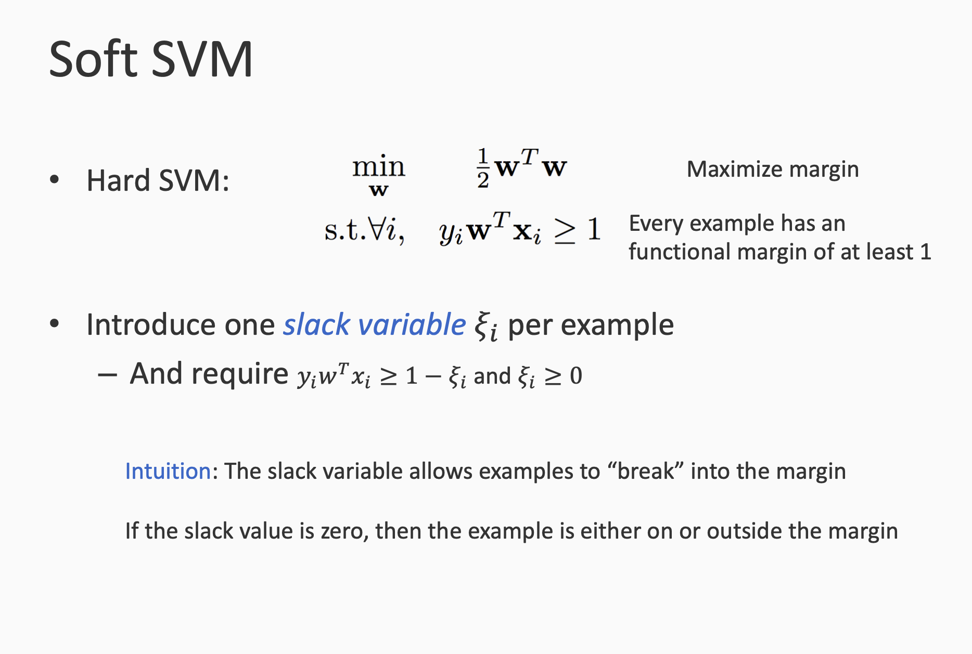

Slide 25
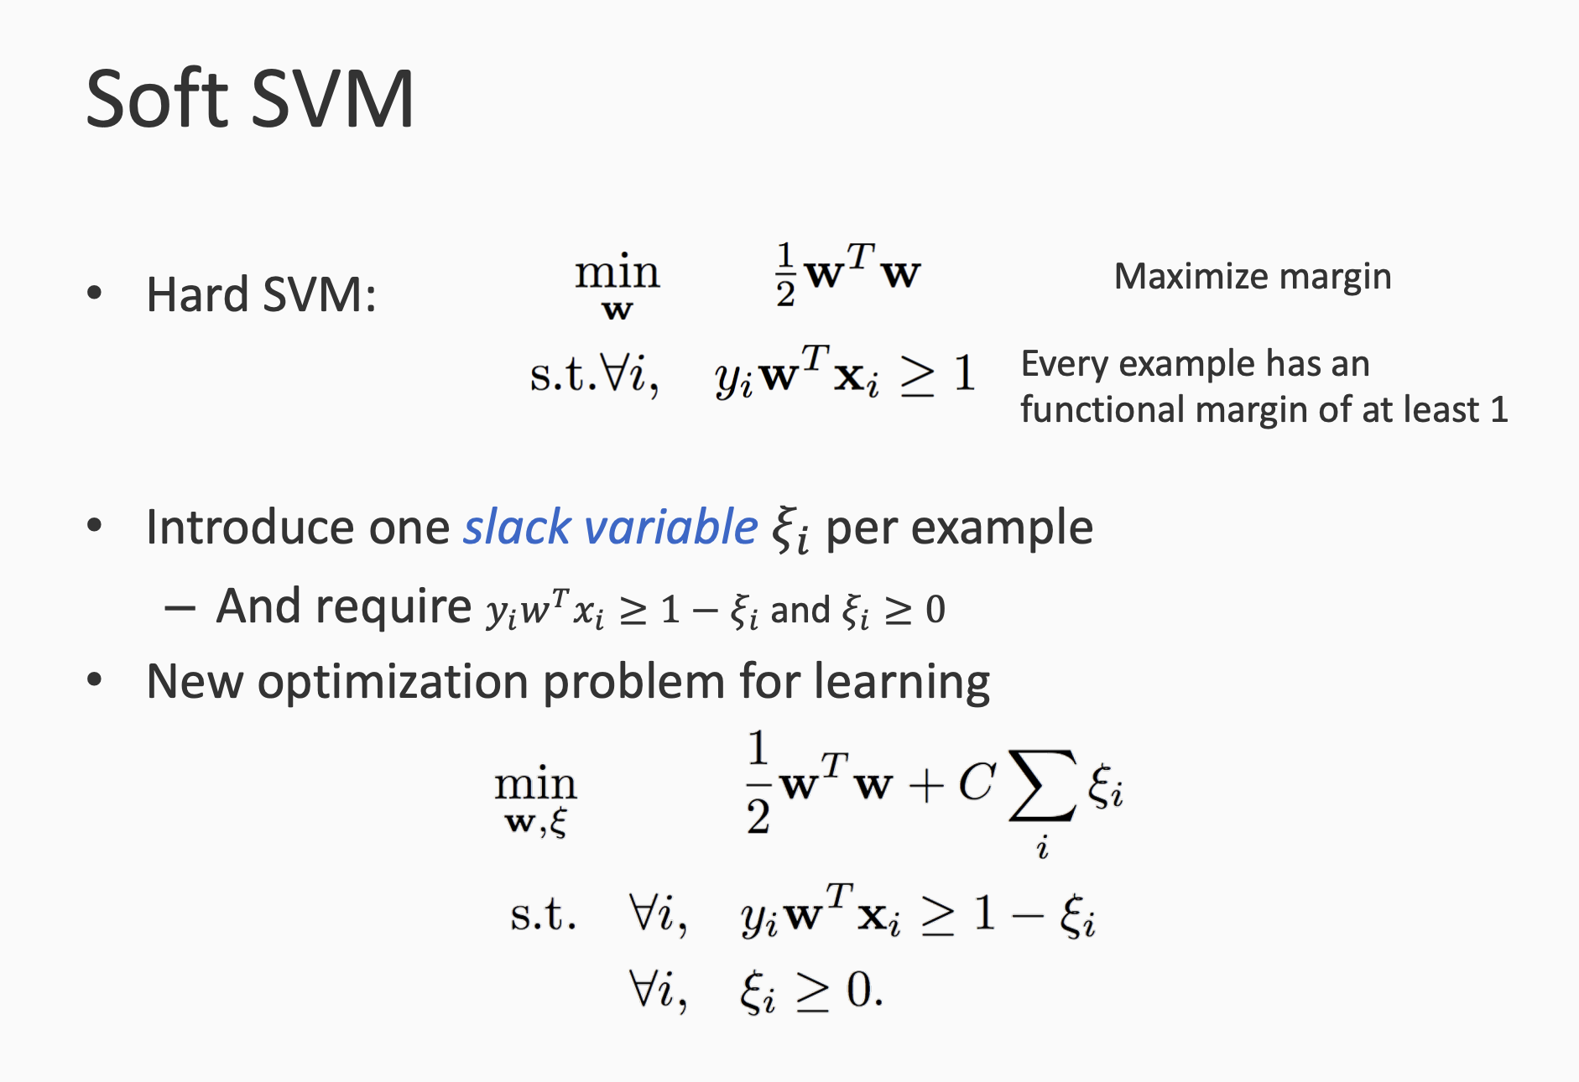

Slide 26
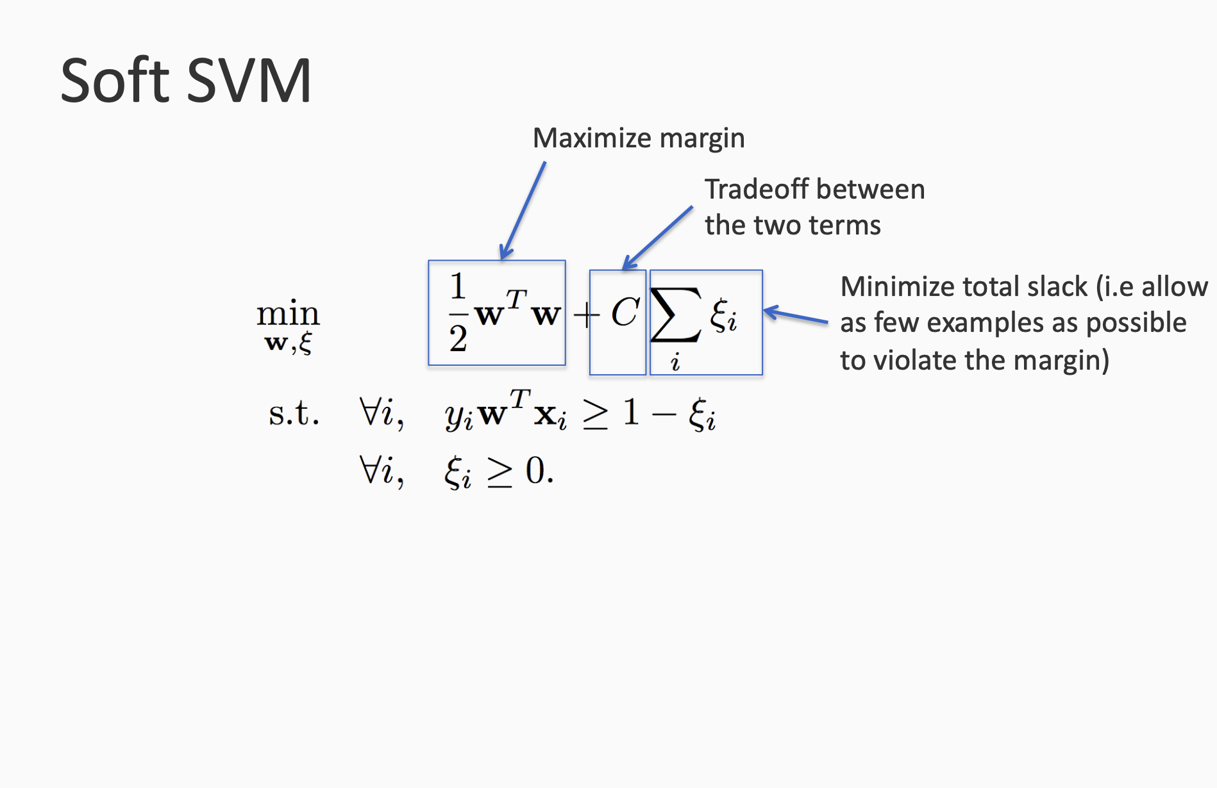

Slide 27
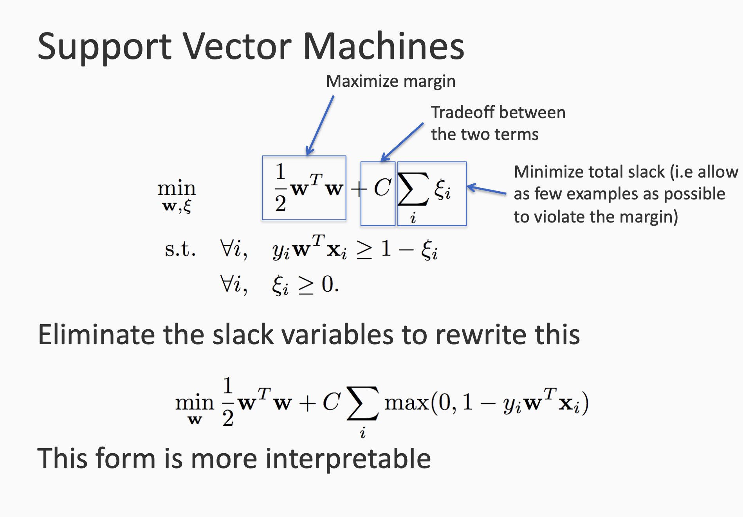

Slide 28
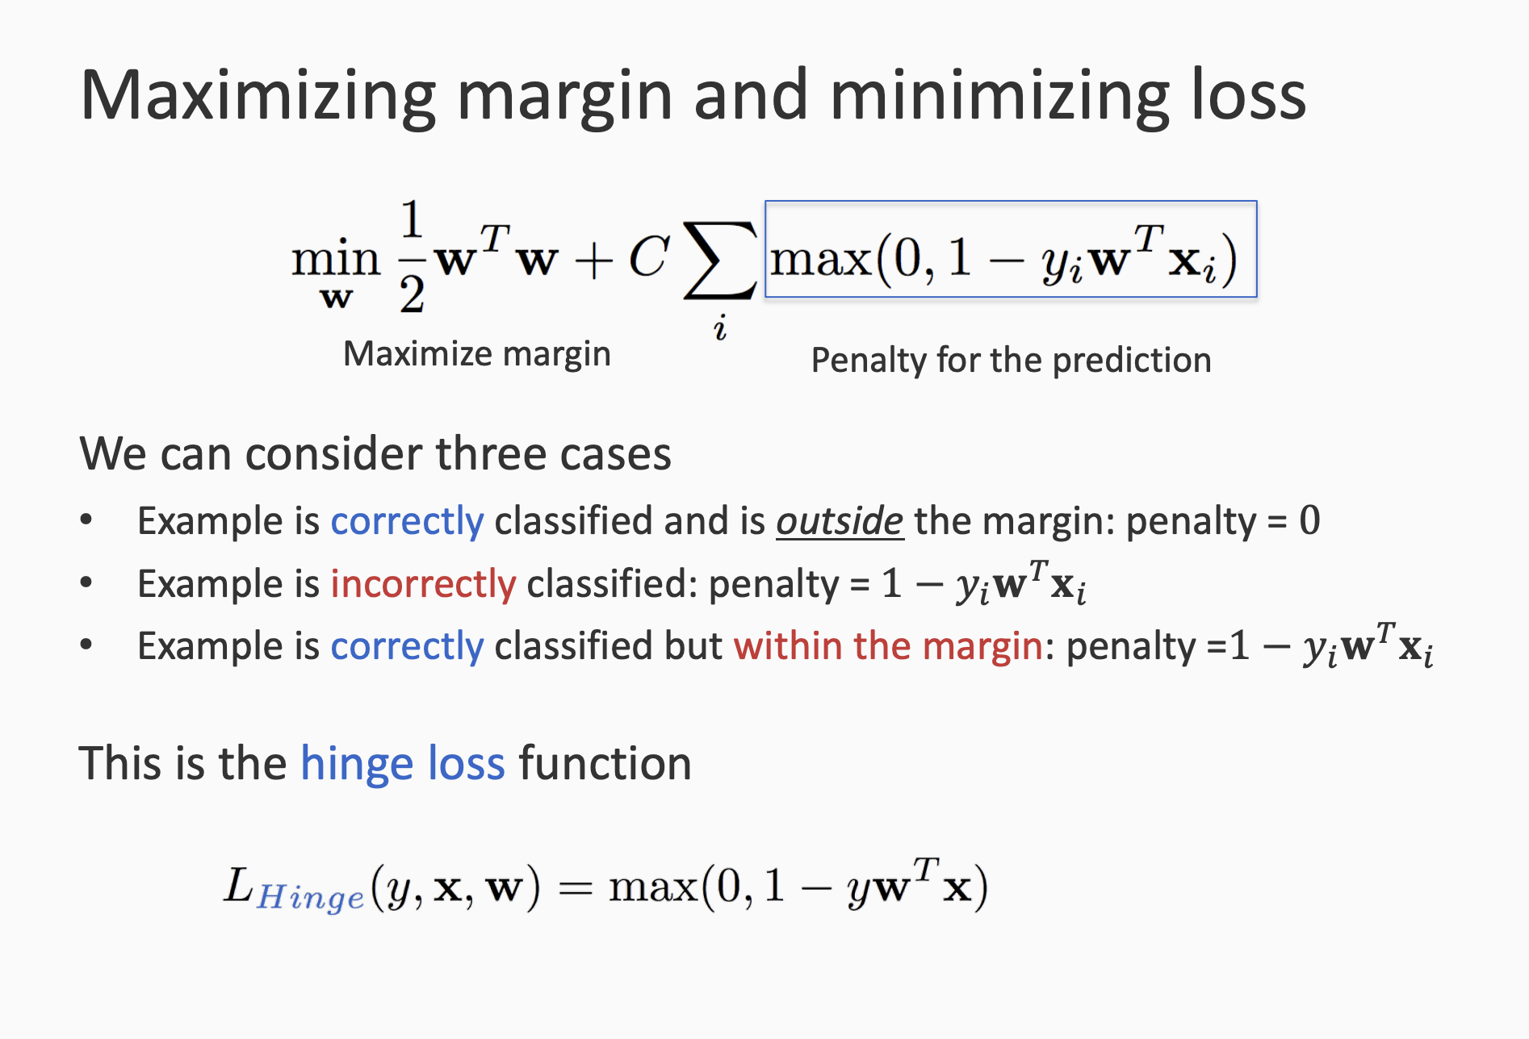

Slide 29
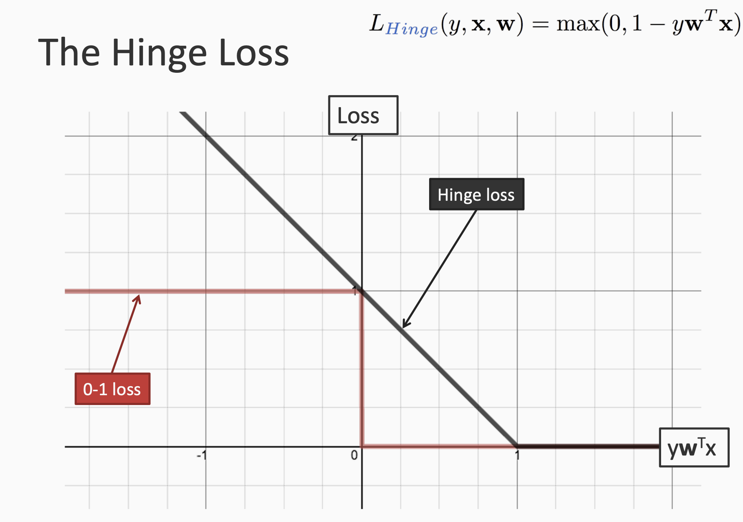

Slide 30
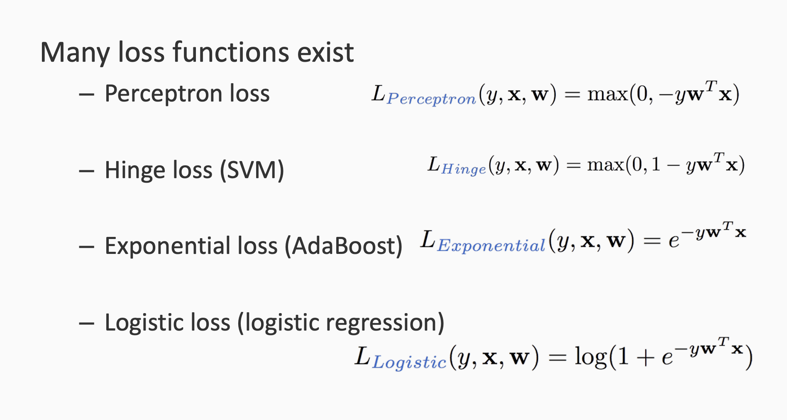
The set of loss functions

Slide 31
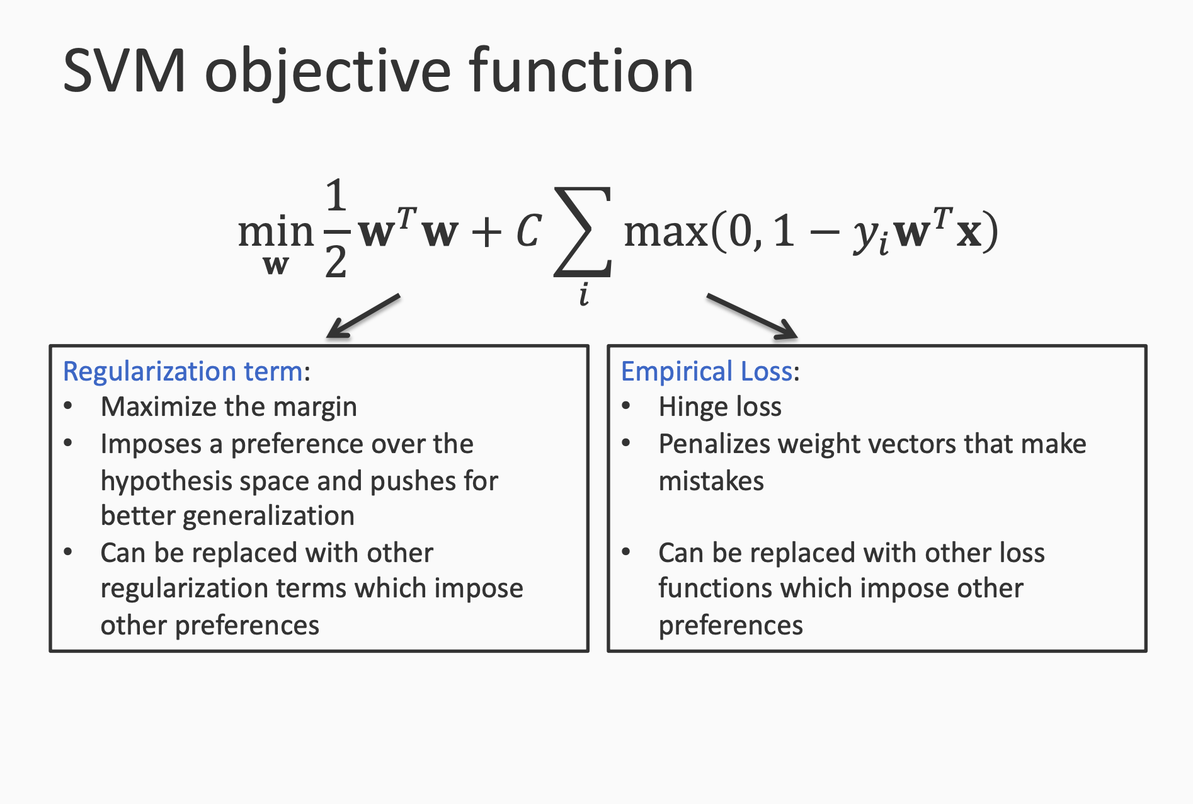

Slide 32
Training SVM

Slide 33
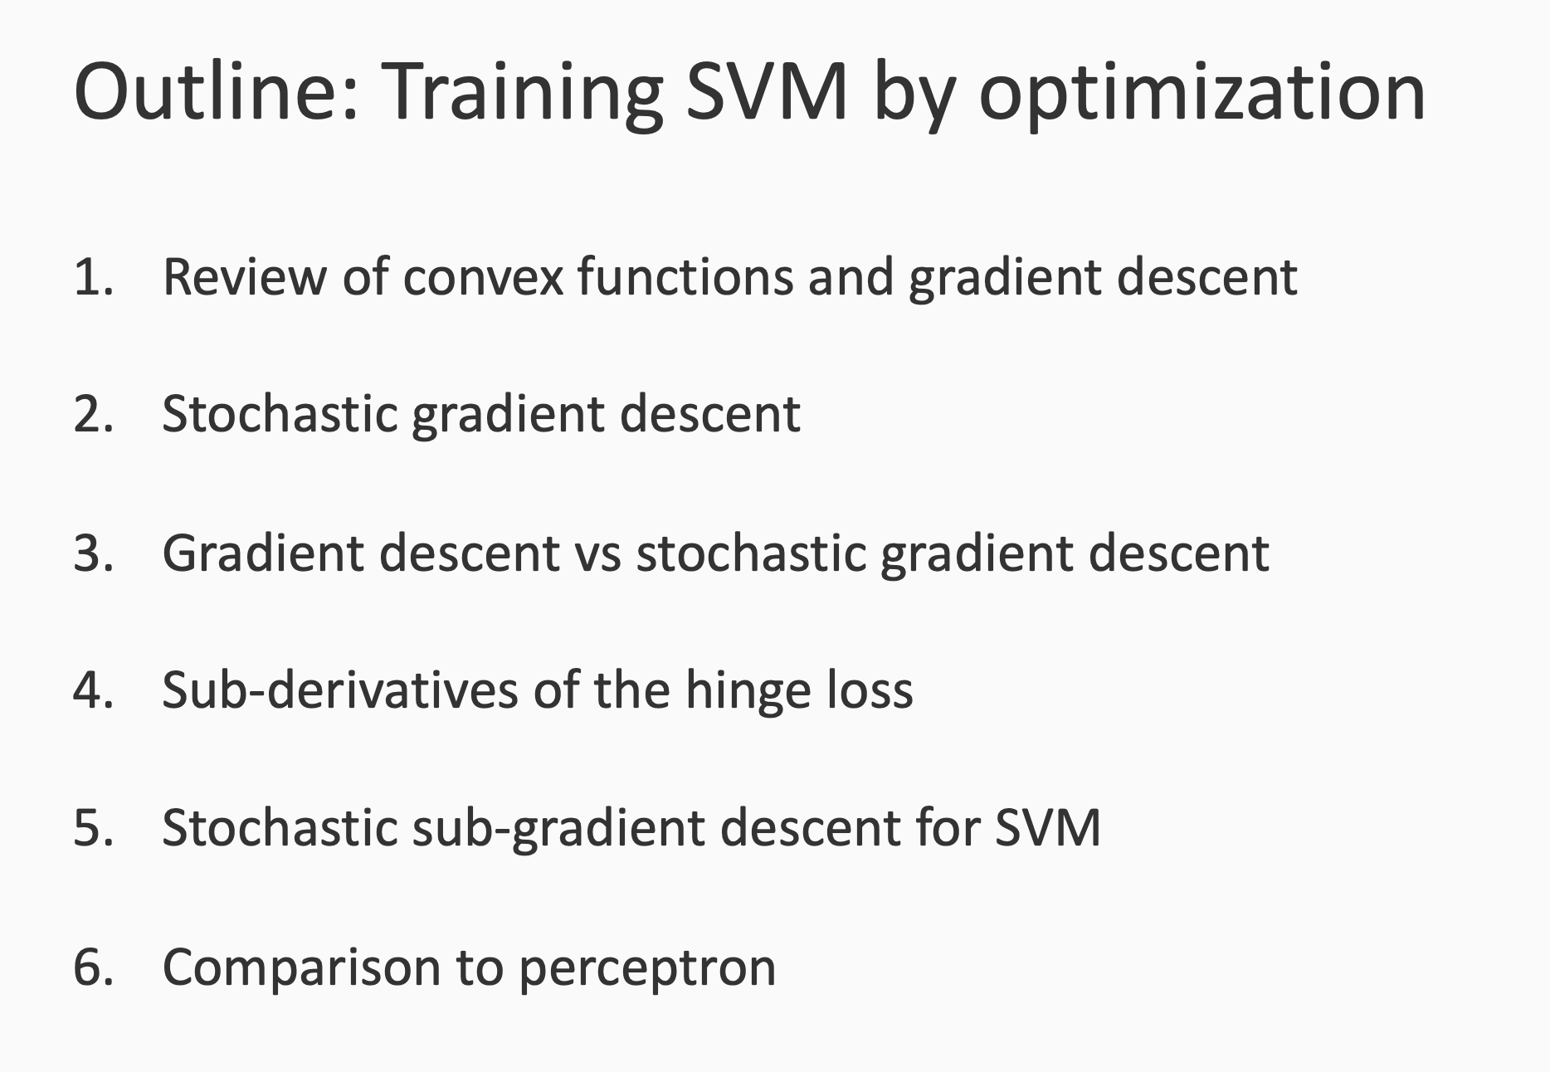

Slide 34
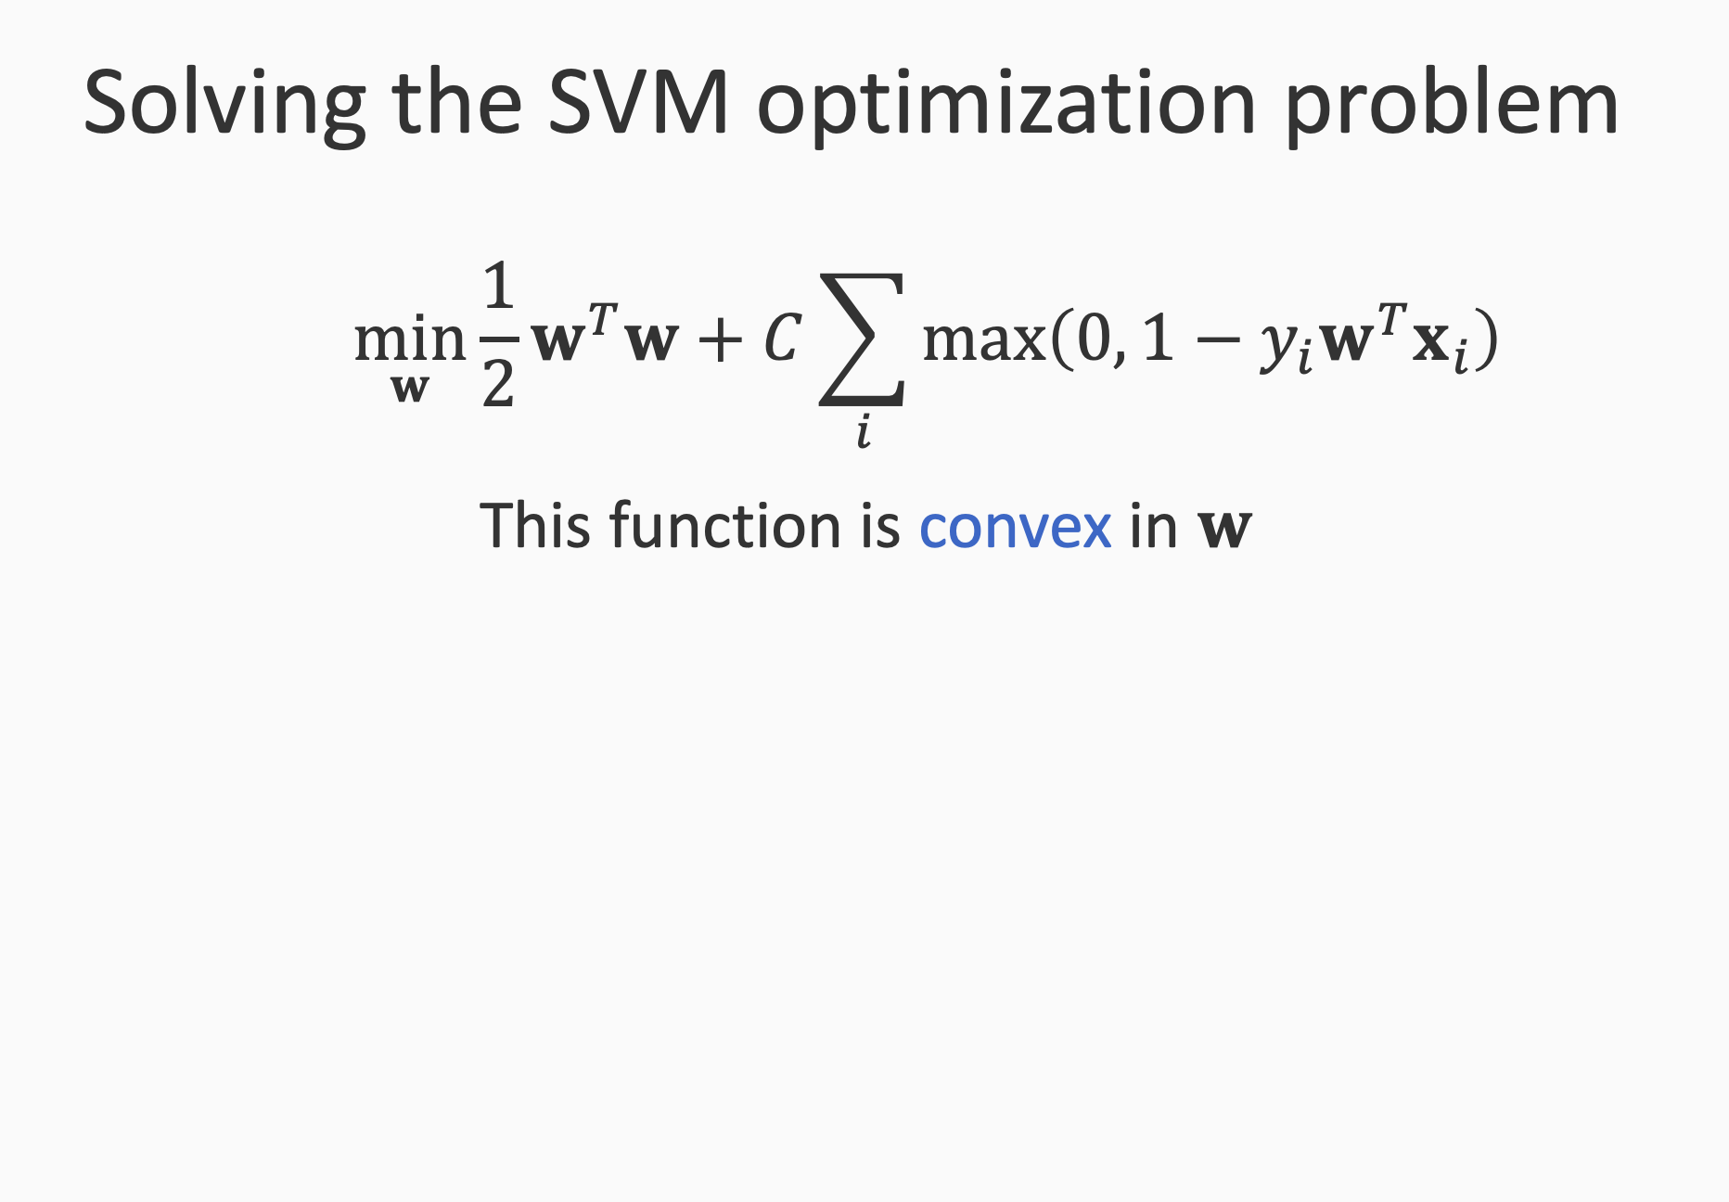

Slide 35
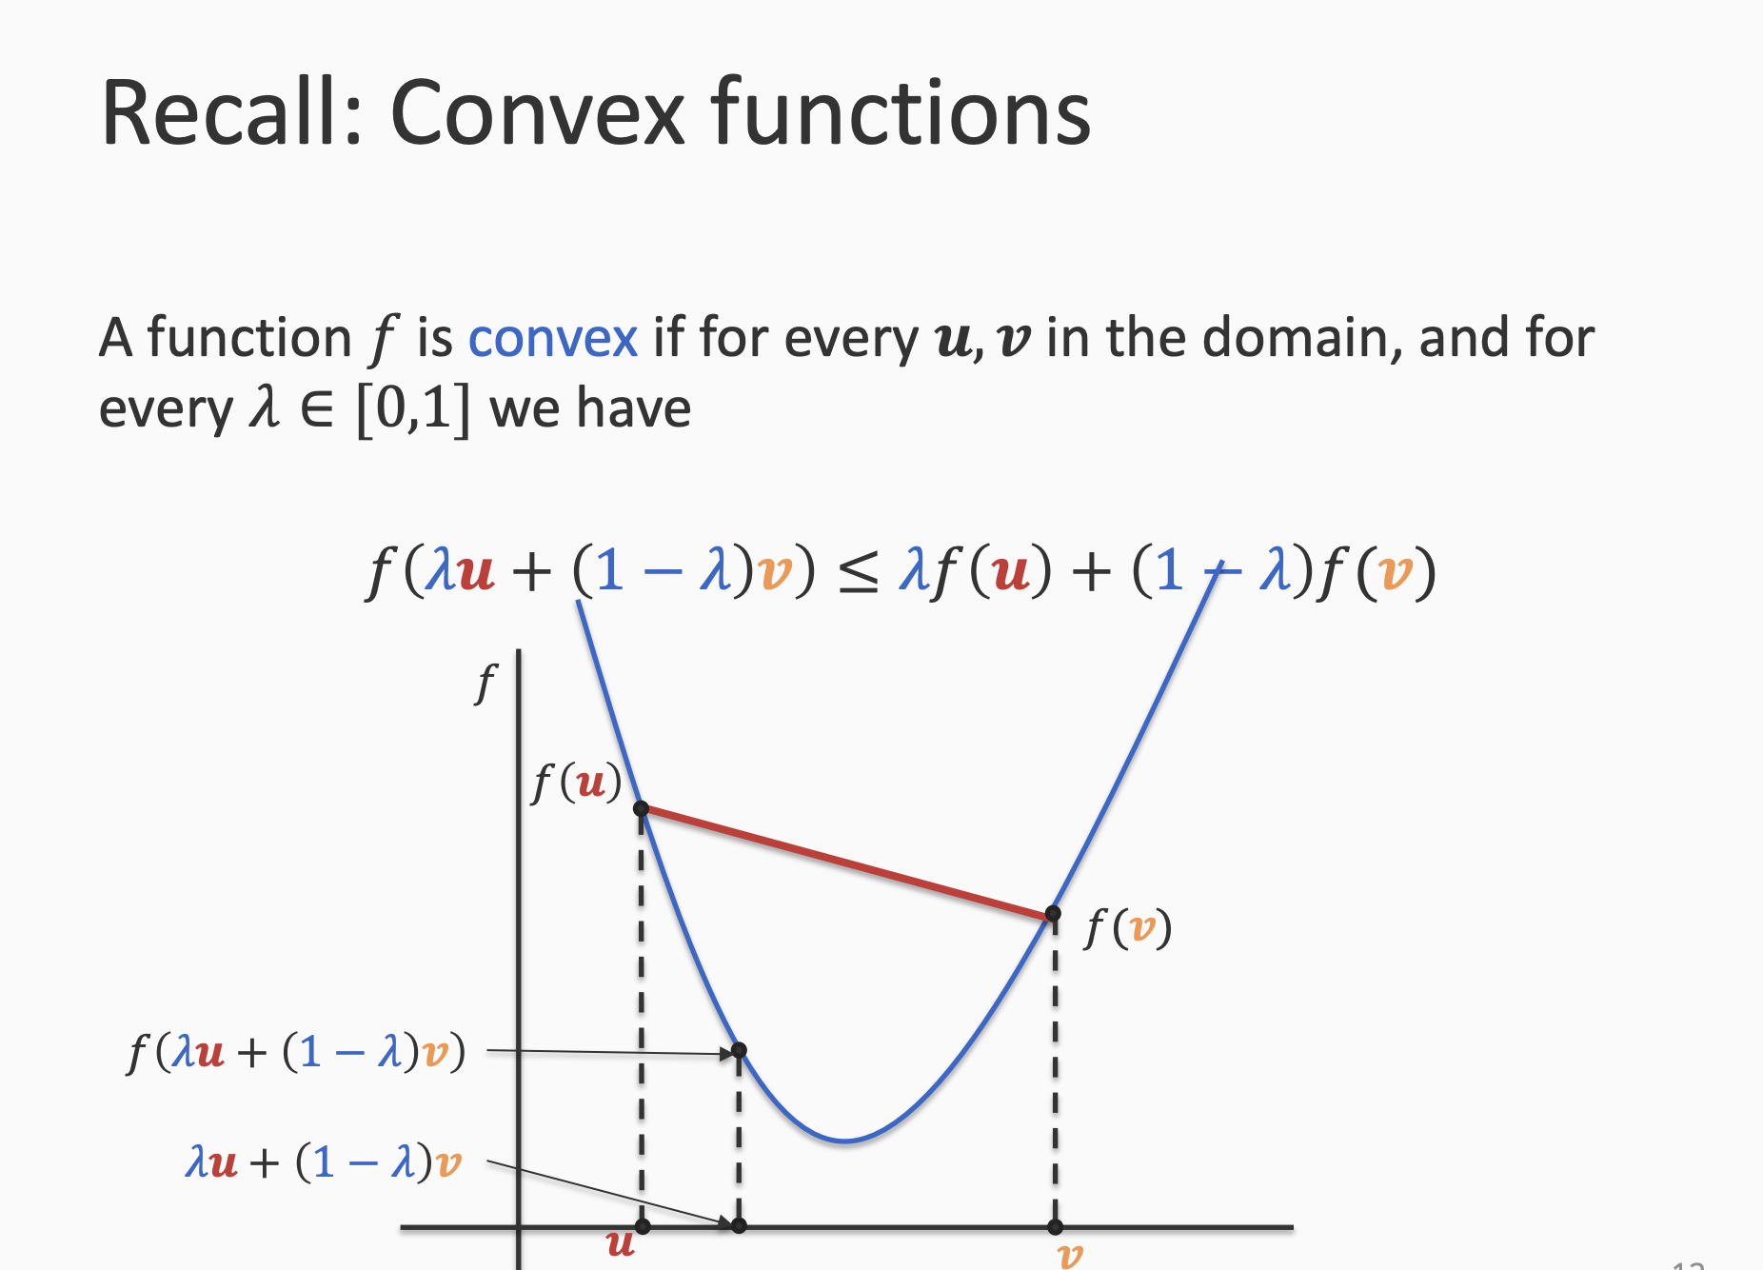

Slide 36
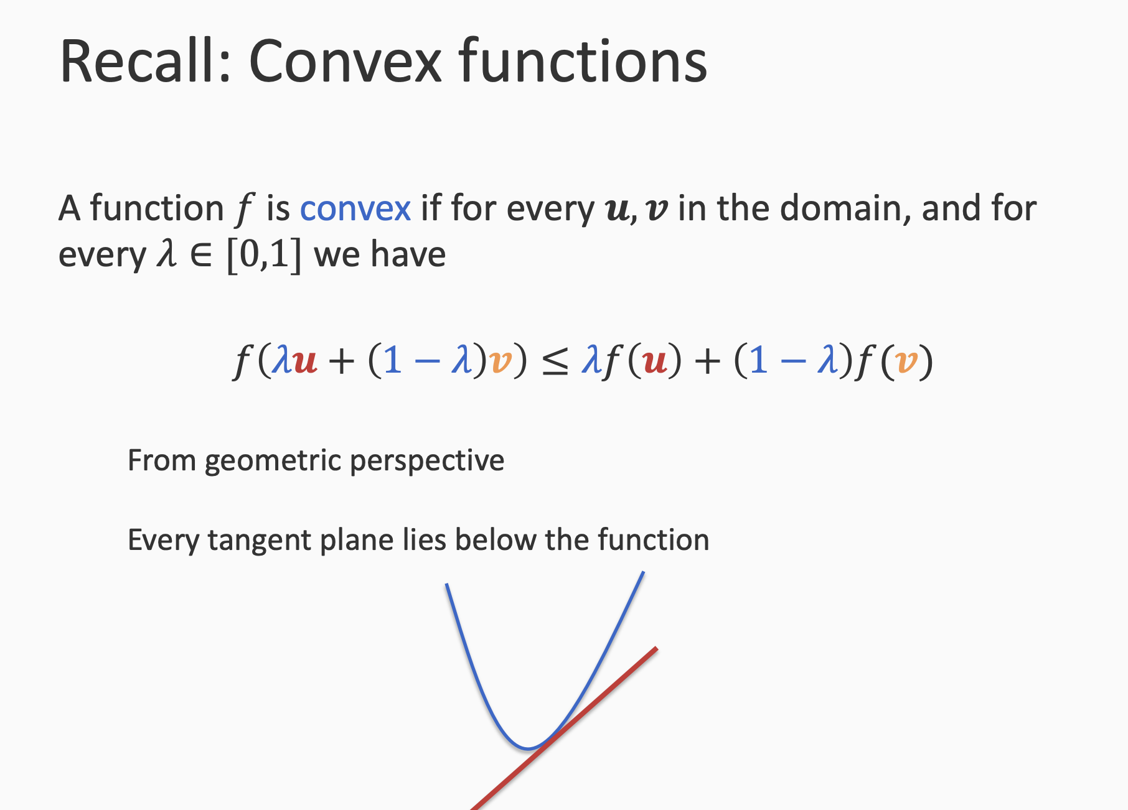

Slide 37
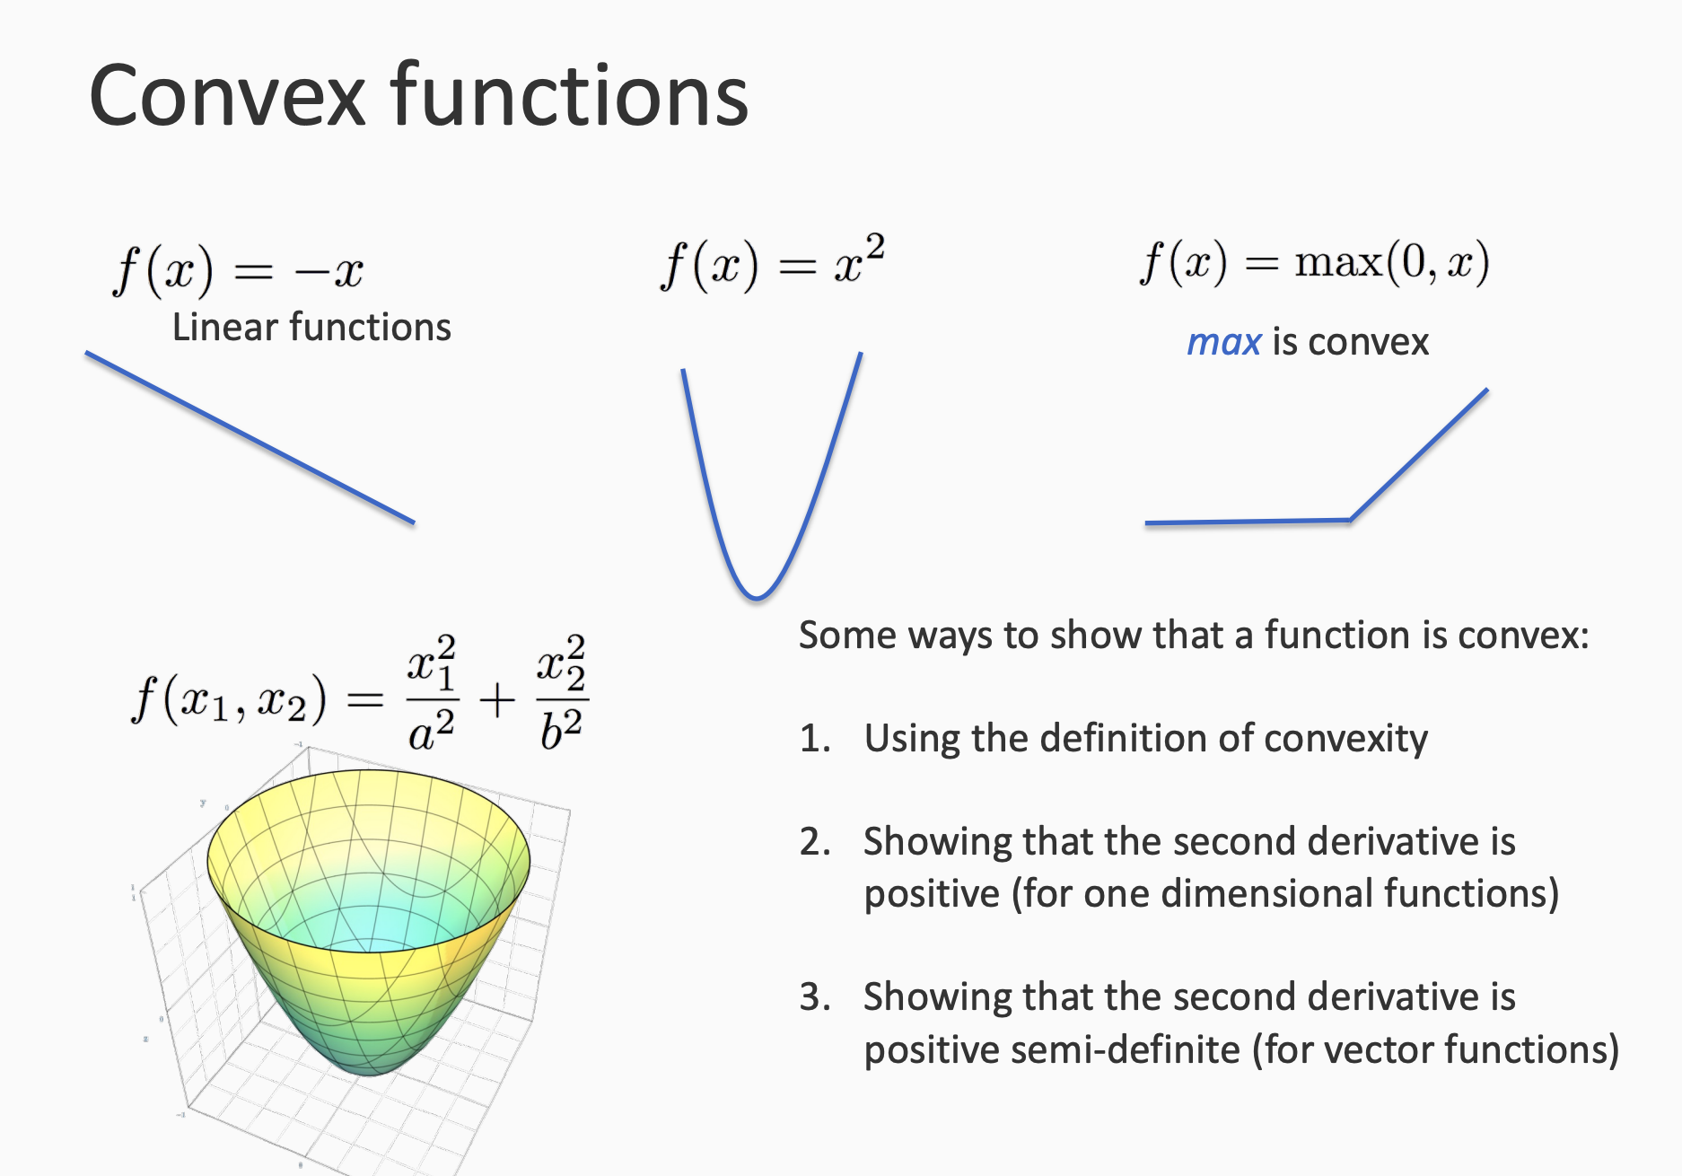

Slide 38
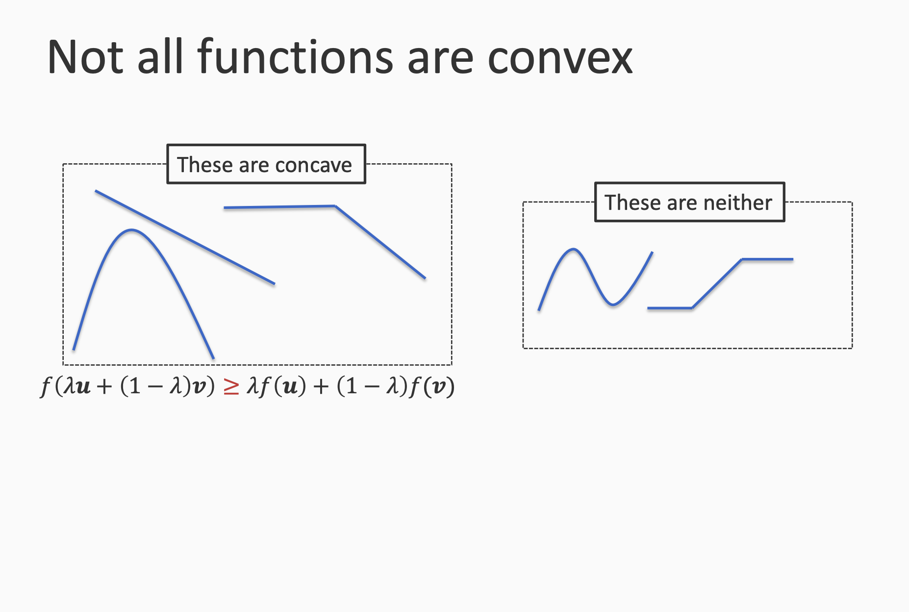

Slide 39
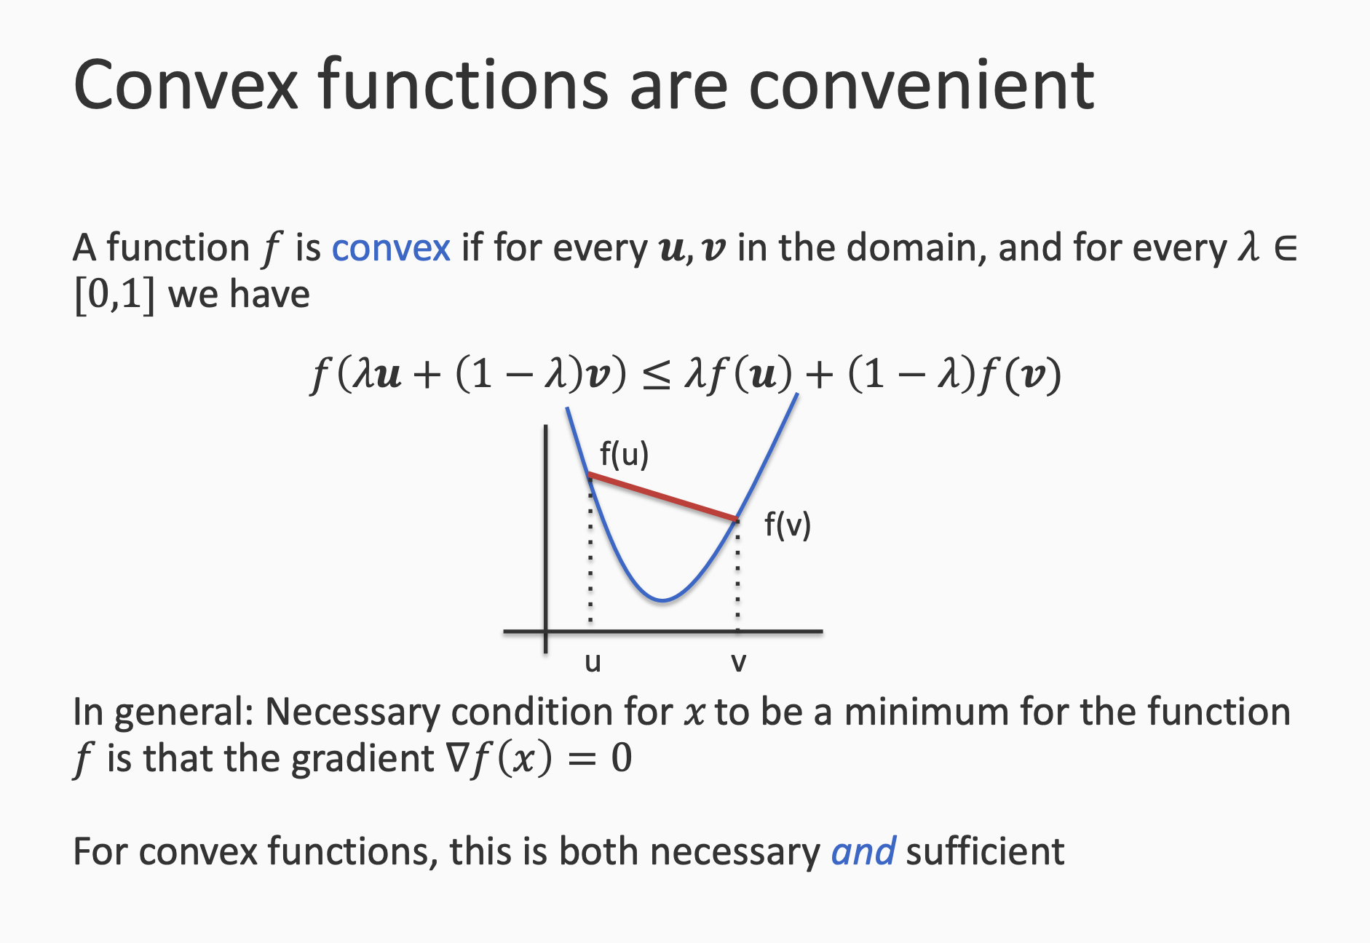

Slide 40
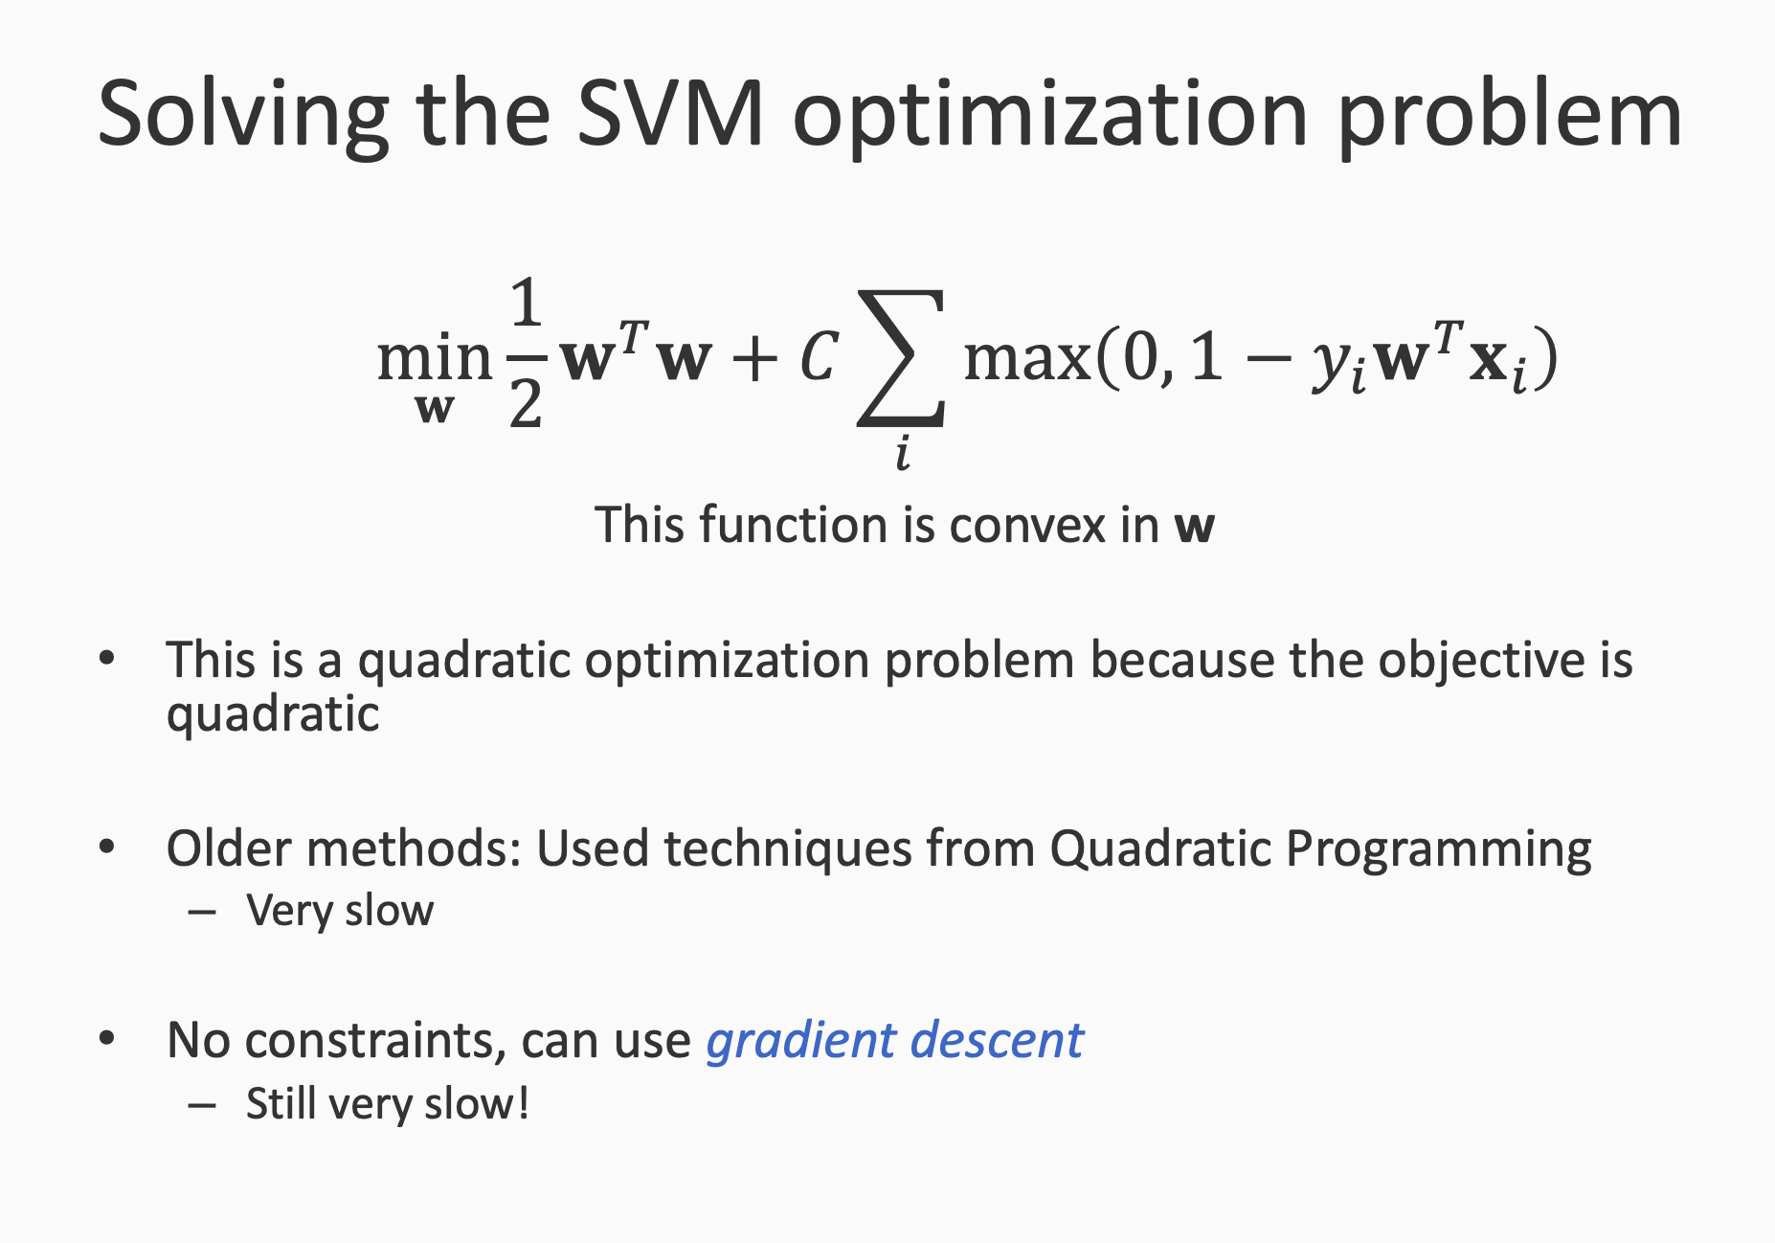

Slide 41
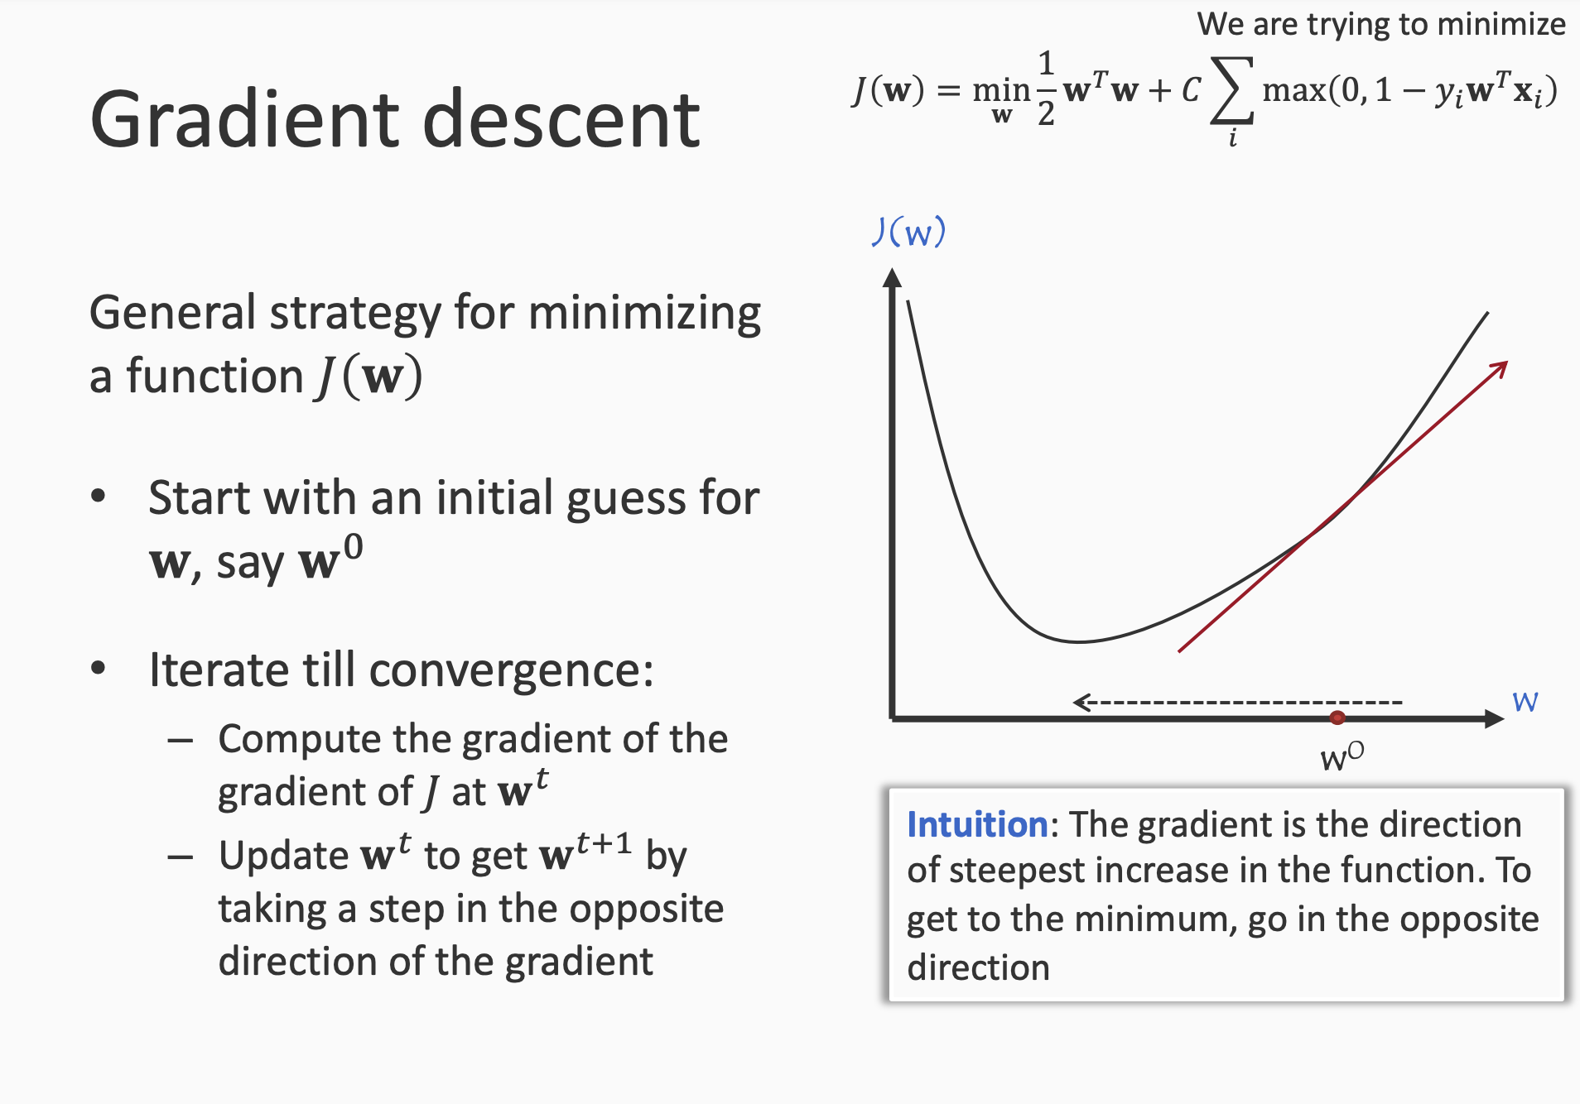

Slide 42
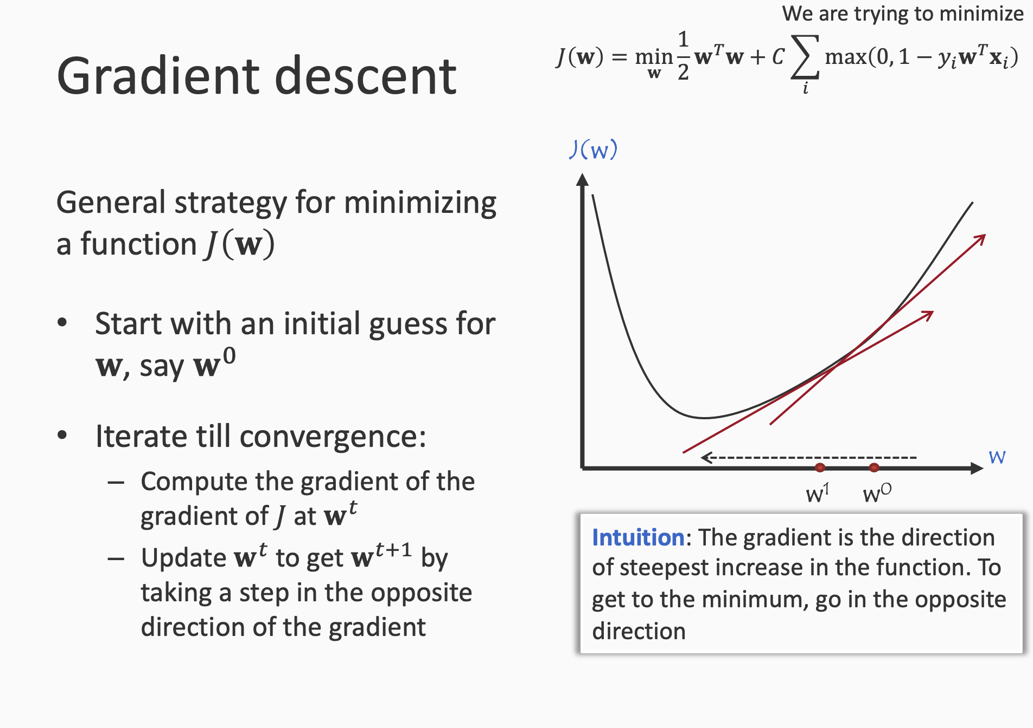

Slide 43
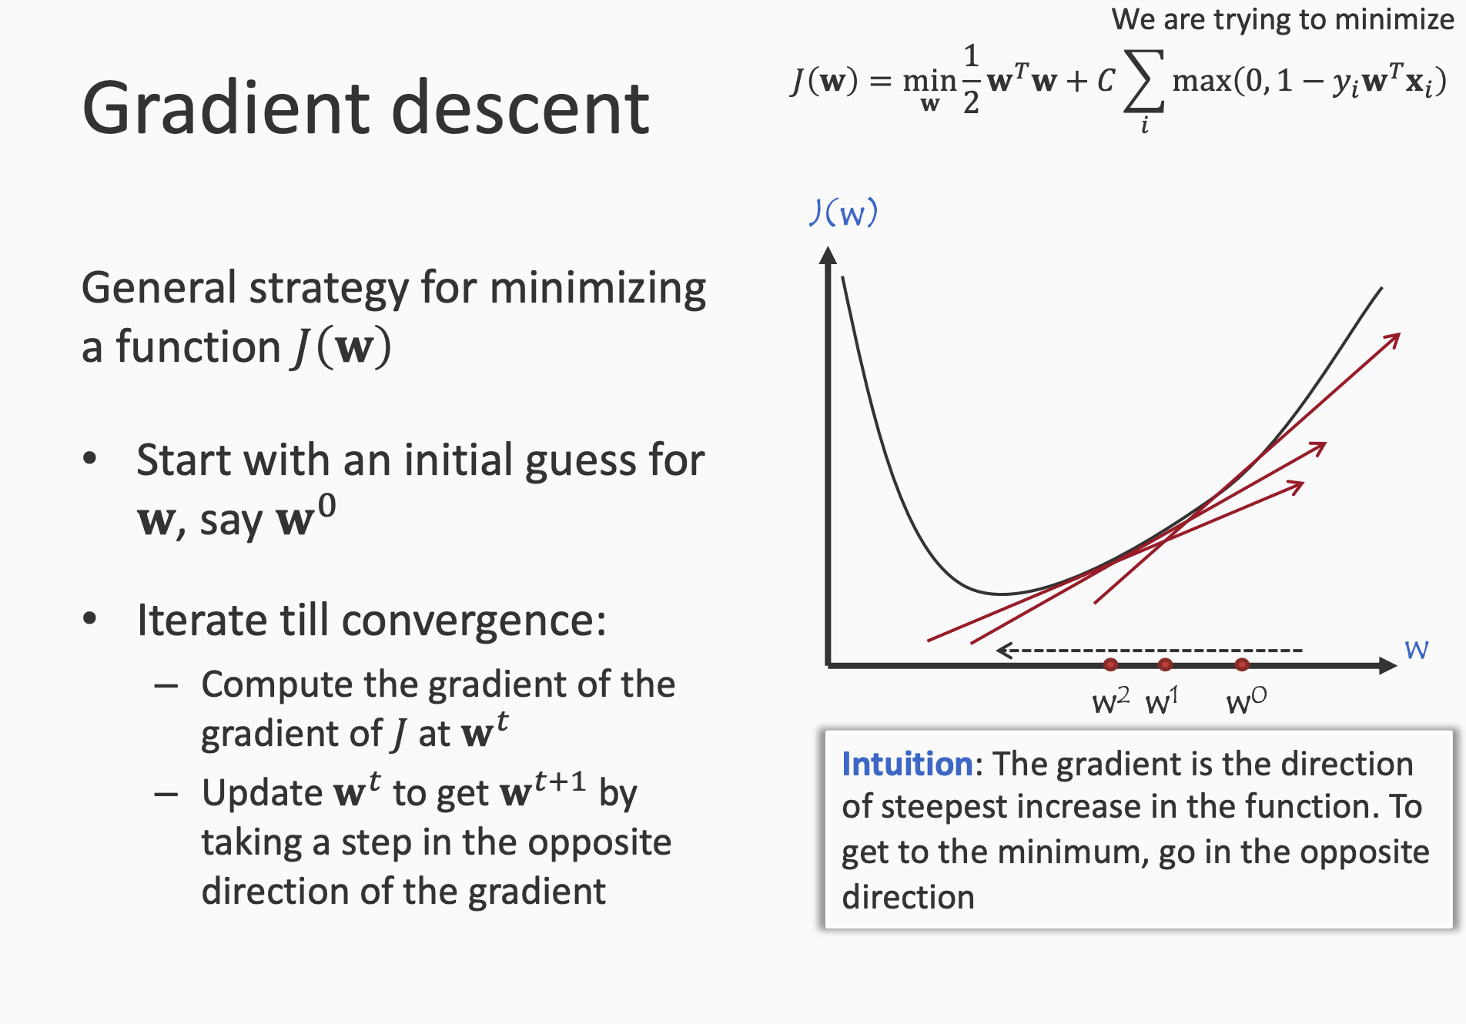

Slide 44
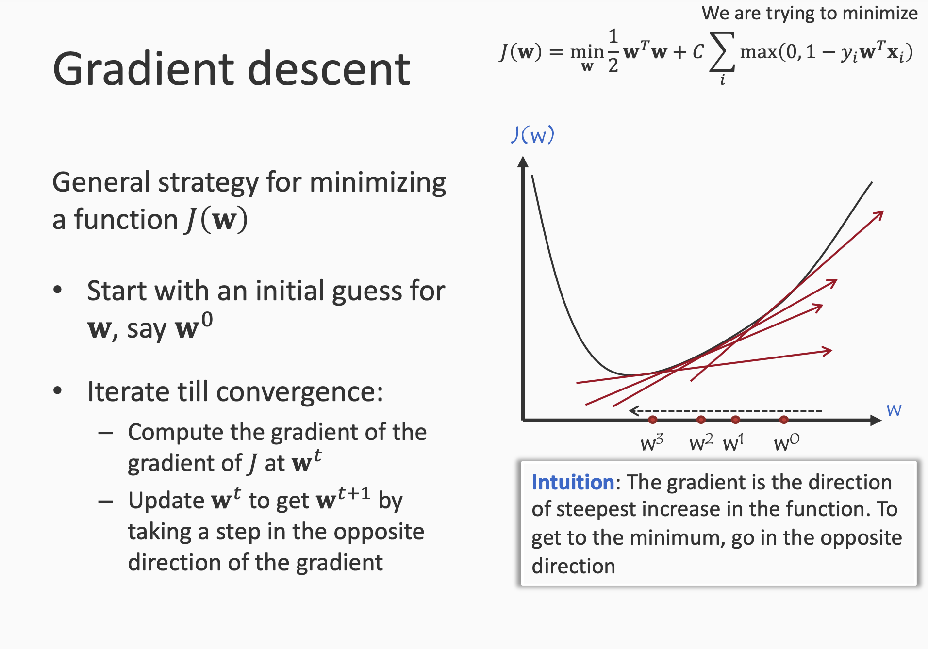

Slide 45
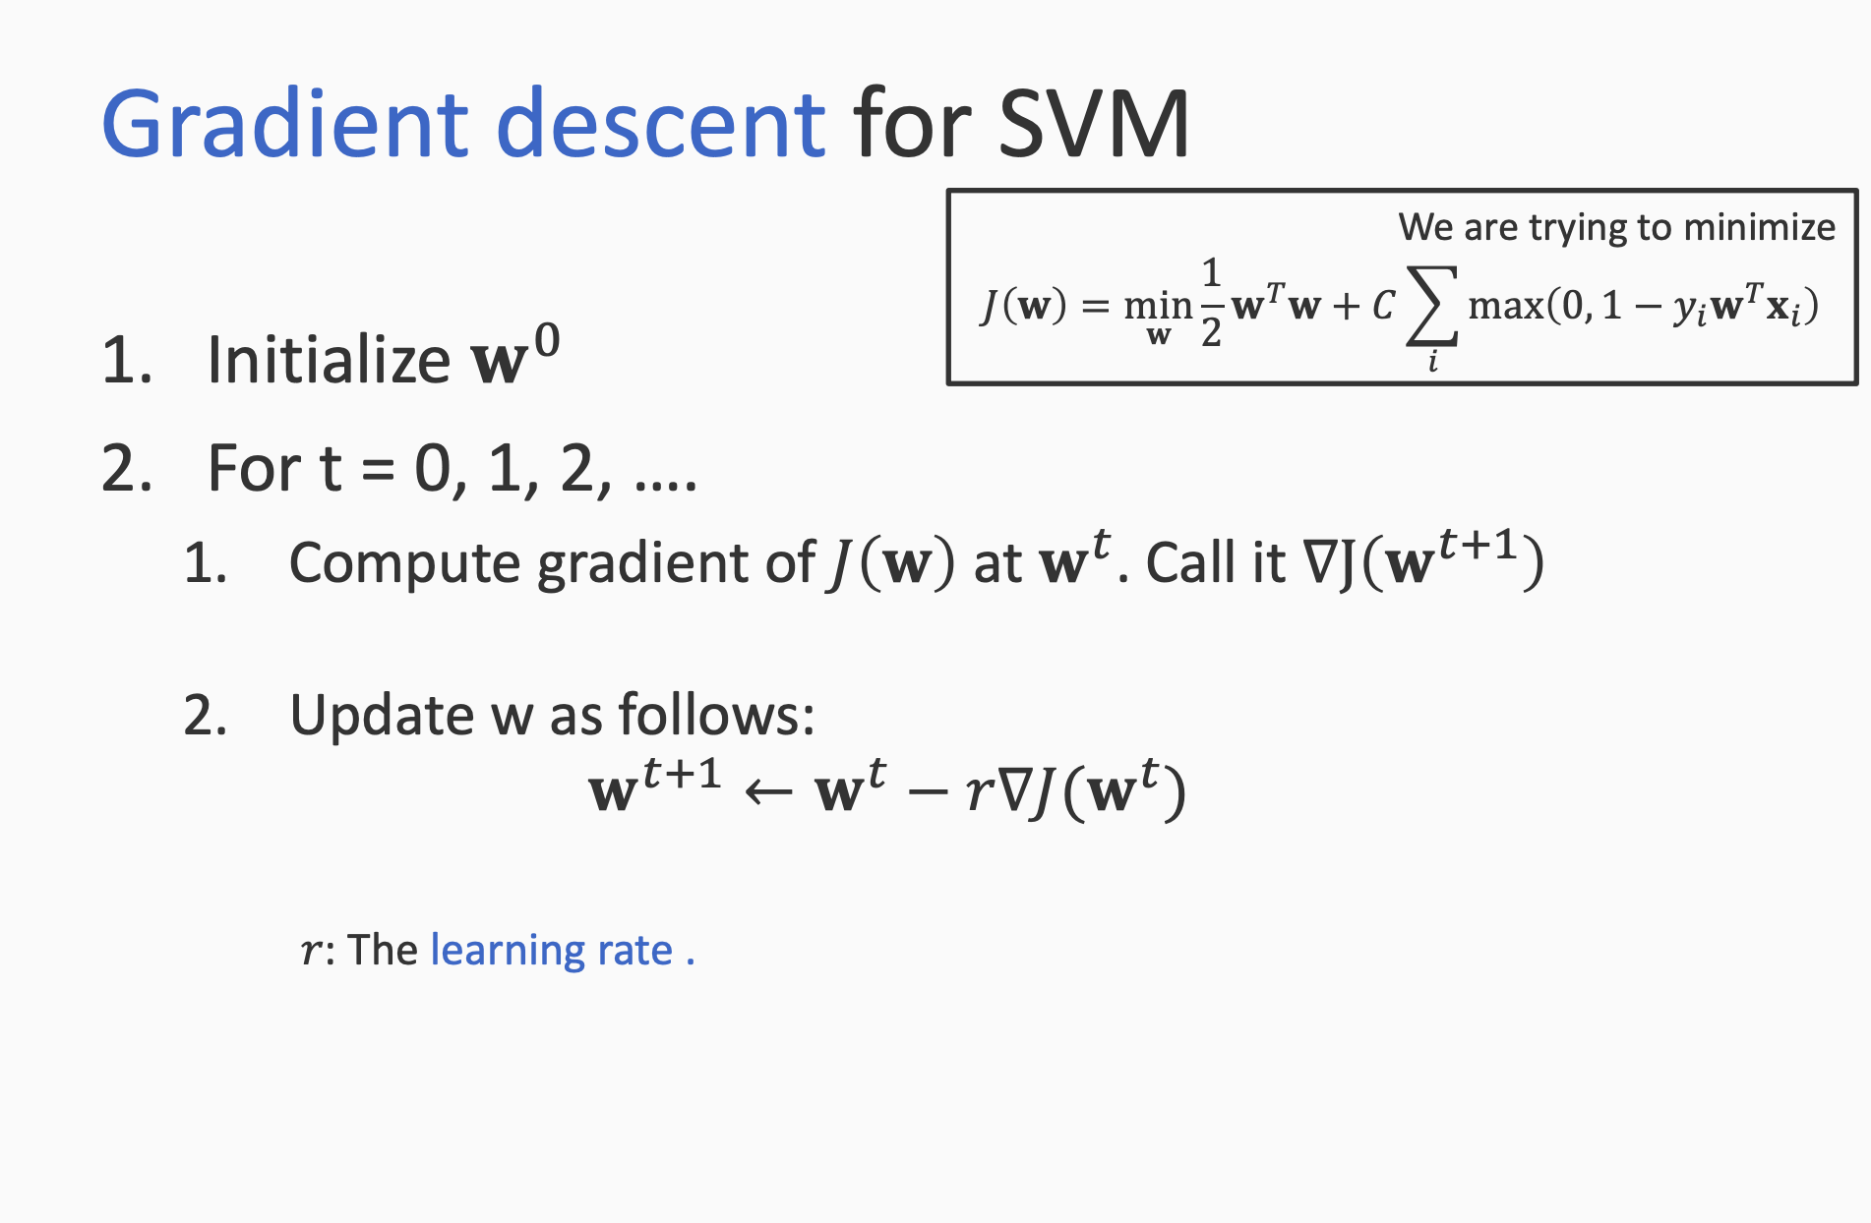

Slide 46
Variants of GD
Batch GD = is also known as GD
Compute the GD over whole dataset
Stochastic GD
Compute GD over 1 single example
Mini-batch GD
In between batch GD and stochastic GD
Lets take a sample of few data points and compute GD over this sample

Slide 47
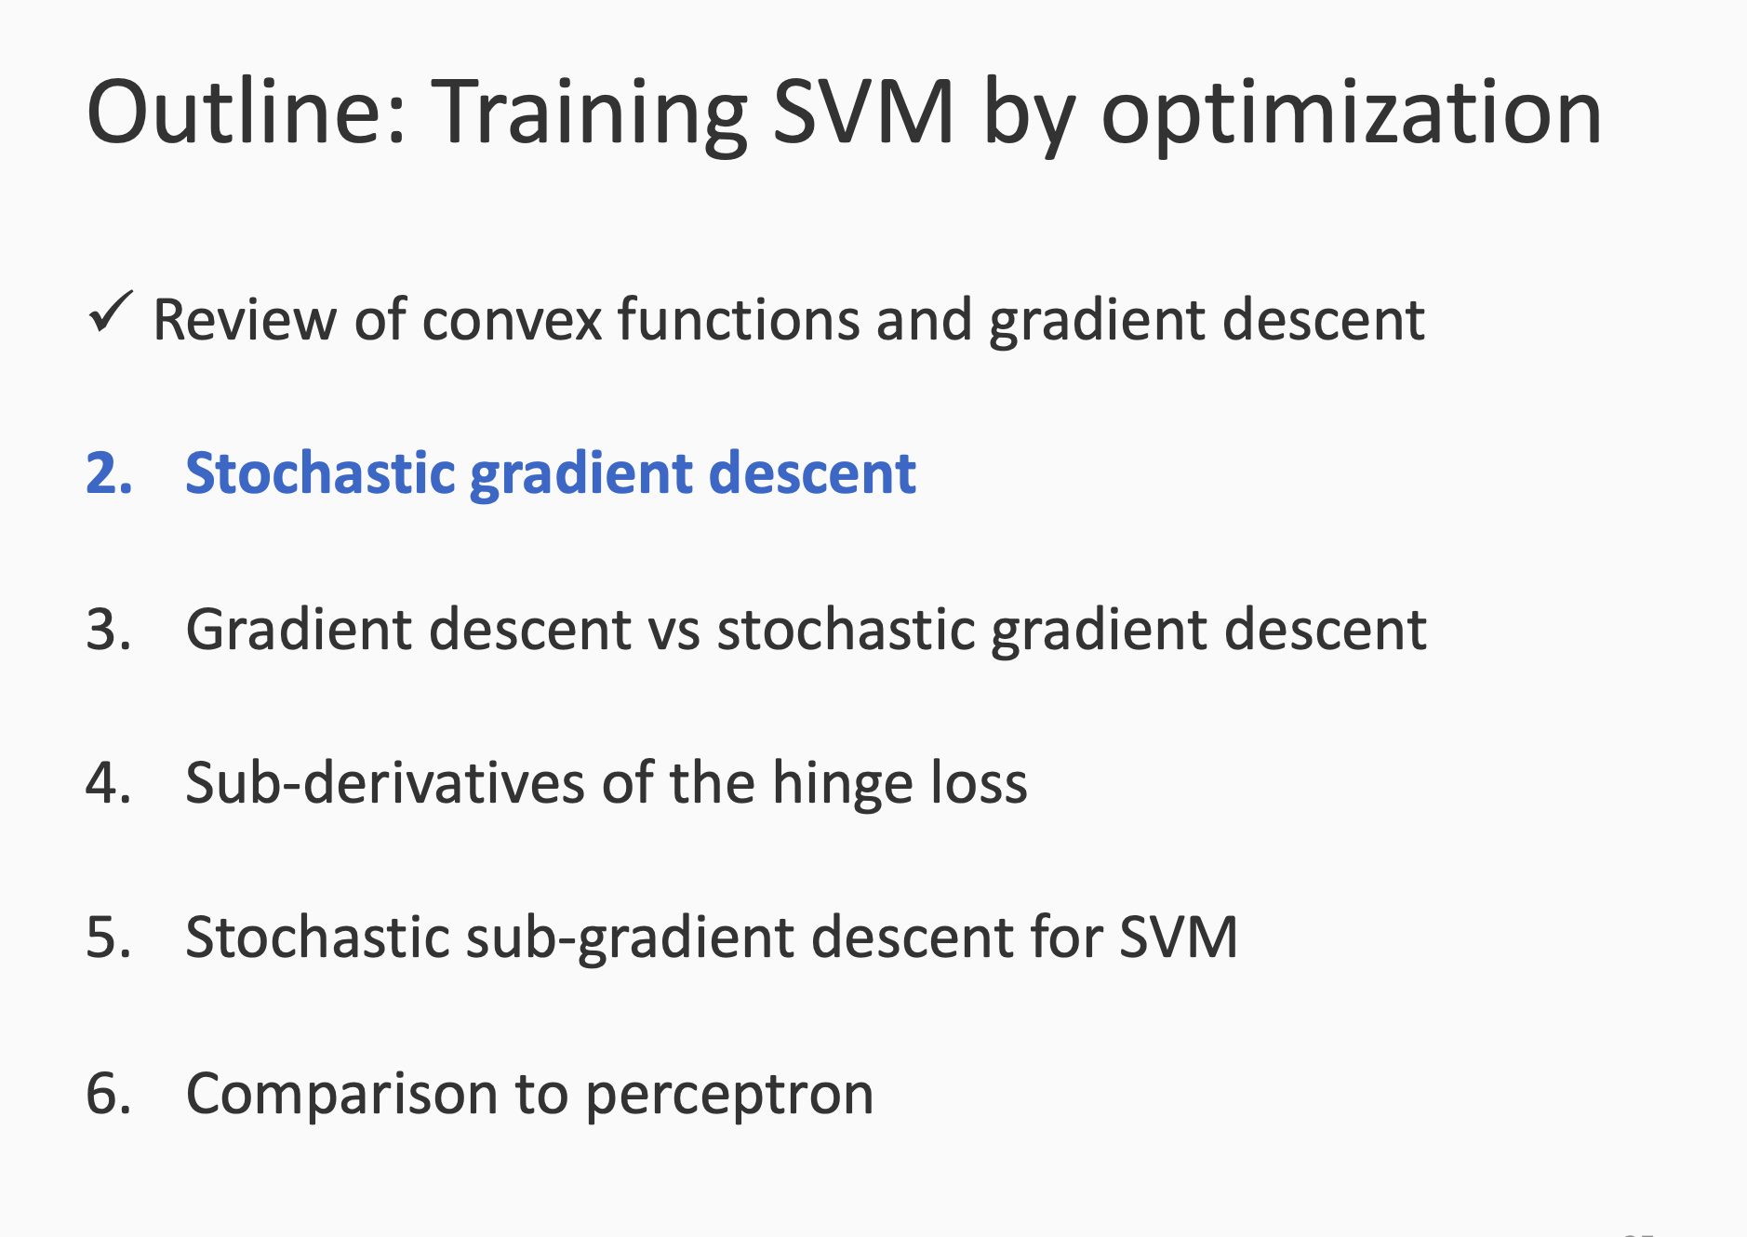

Slide 48
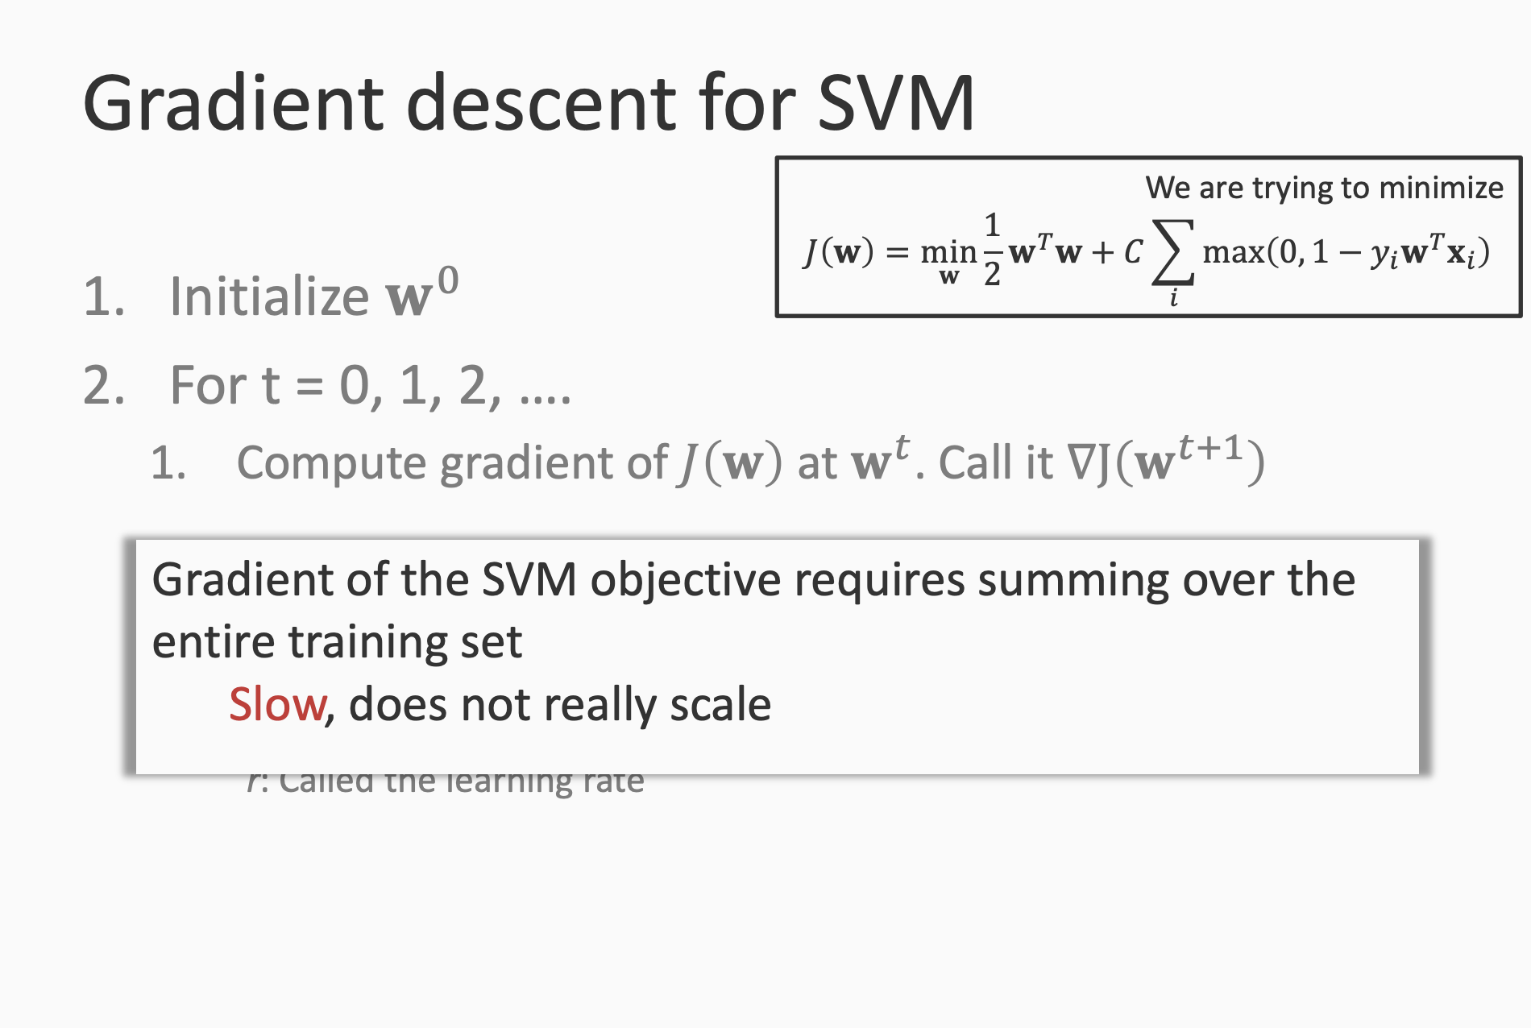

Slide 49
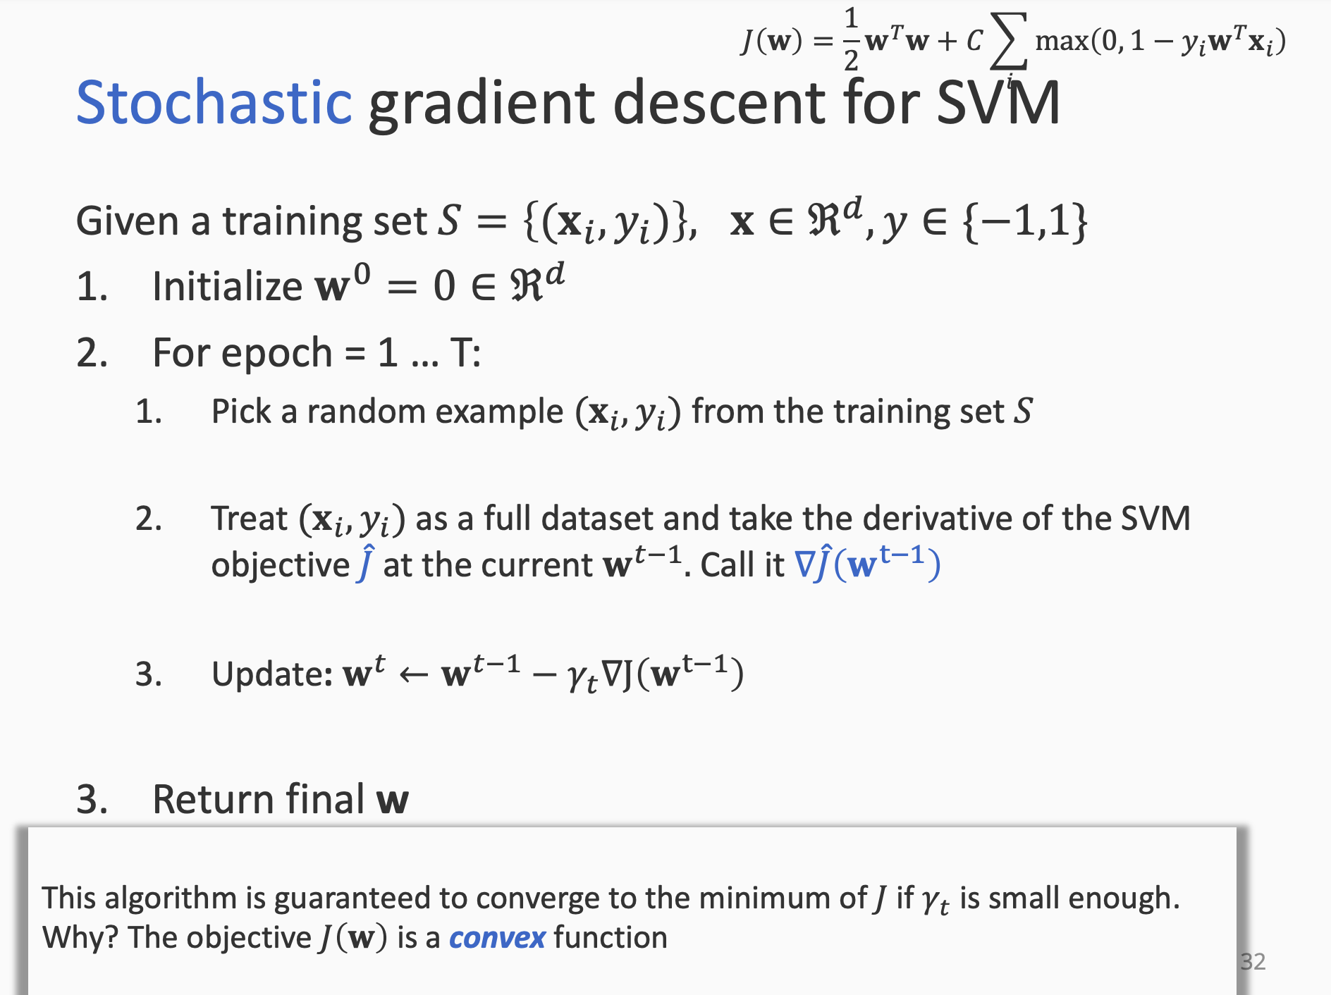

Slide 50
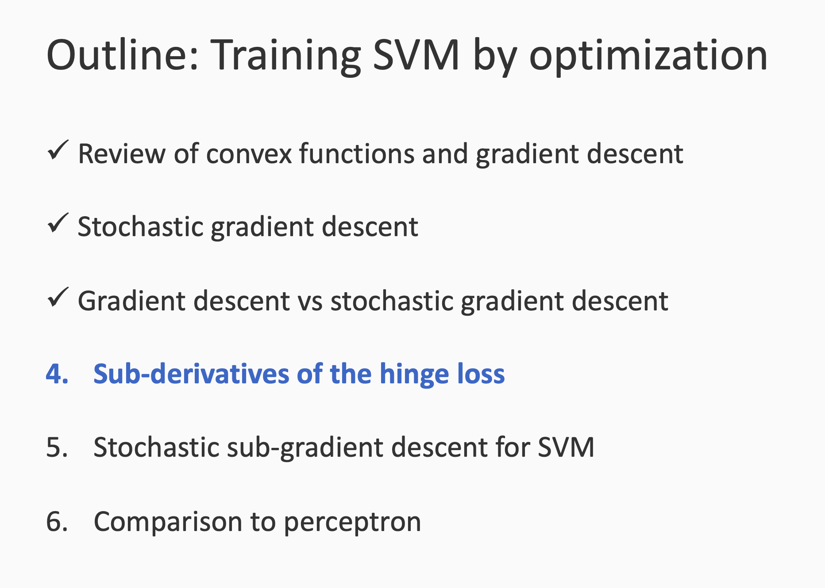

Slide 51
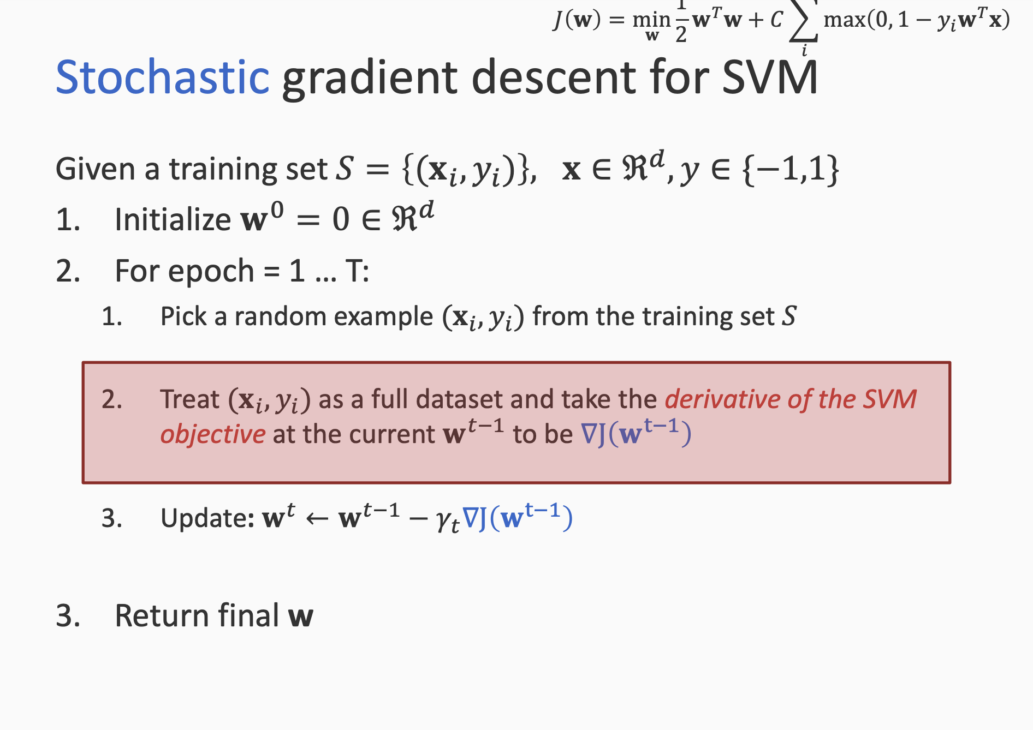

Slide 52
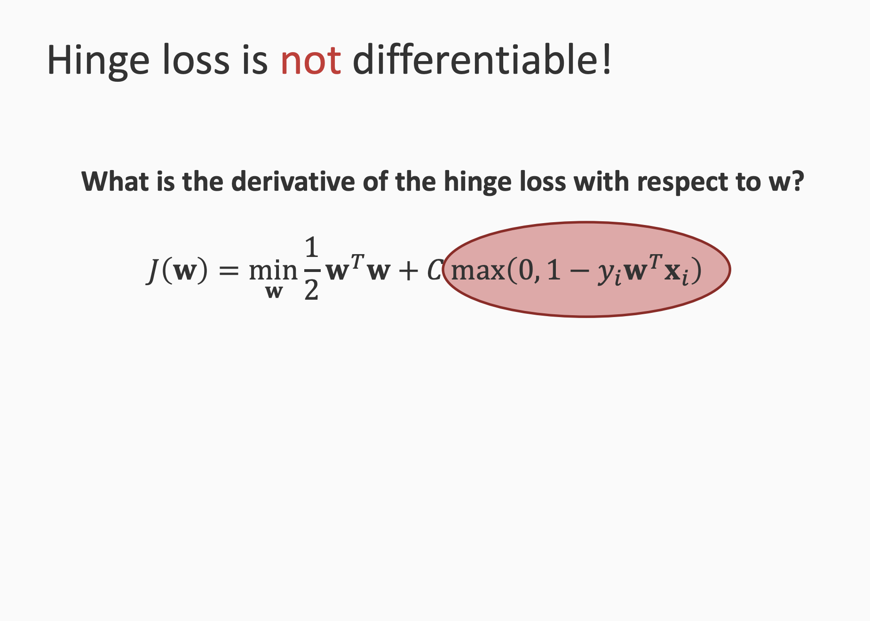

Slide 53
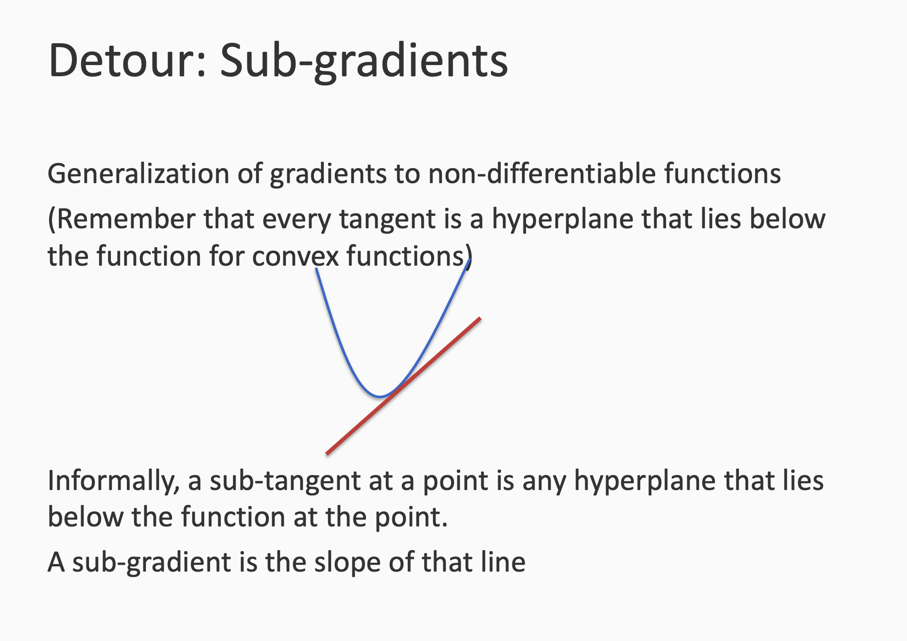

Slide 54
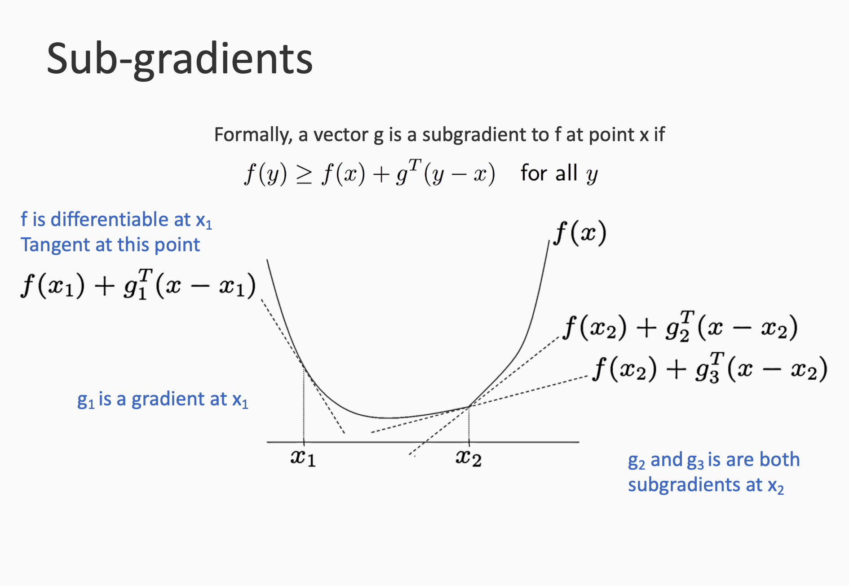

Slide 55
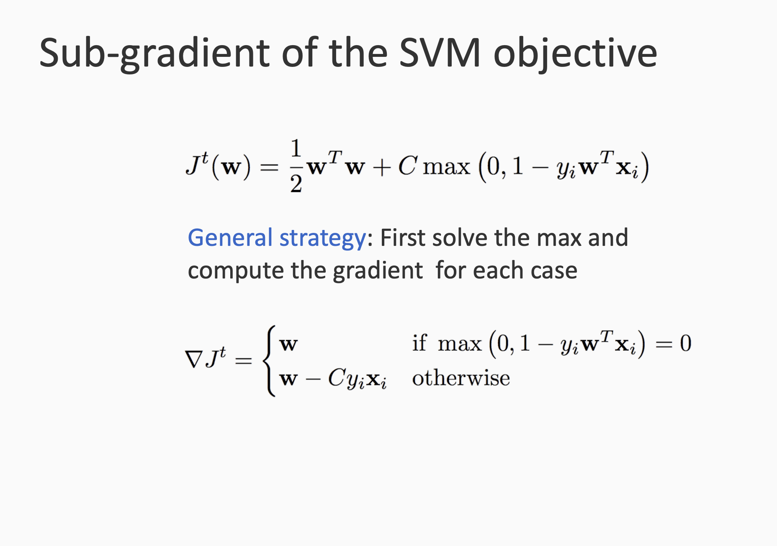

Slide 56


Slide 57


Slide 58


Slide 59


Slide 60
Reference
https://svivek.com/teaching/lectures/slides/svm/svm-sgd.pdf
https://svivek.com/teaching/lectures/slides/svm/svm-intro.pdf

